Slide 1
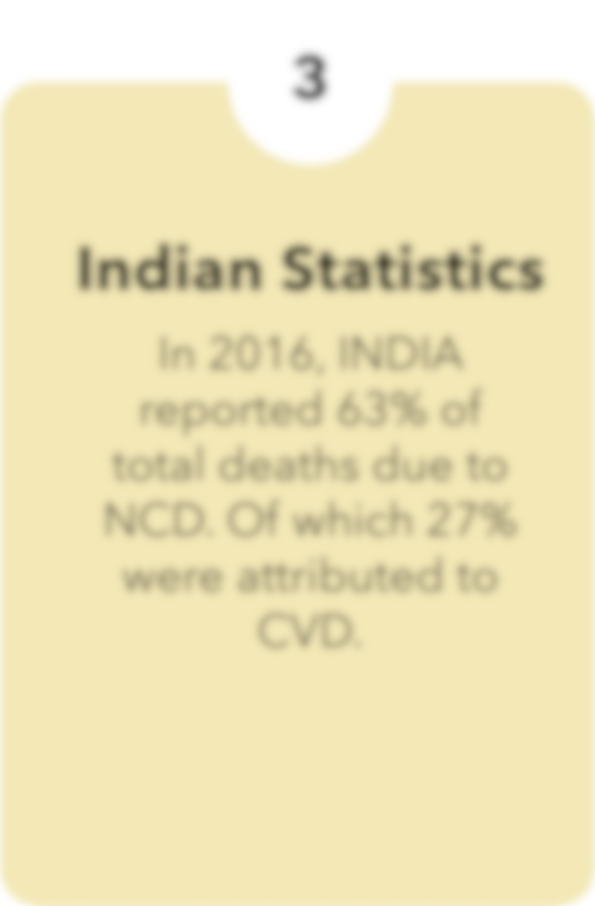
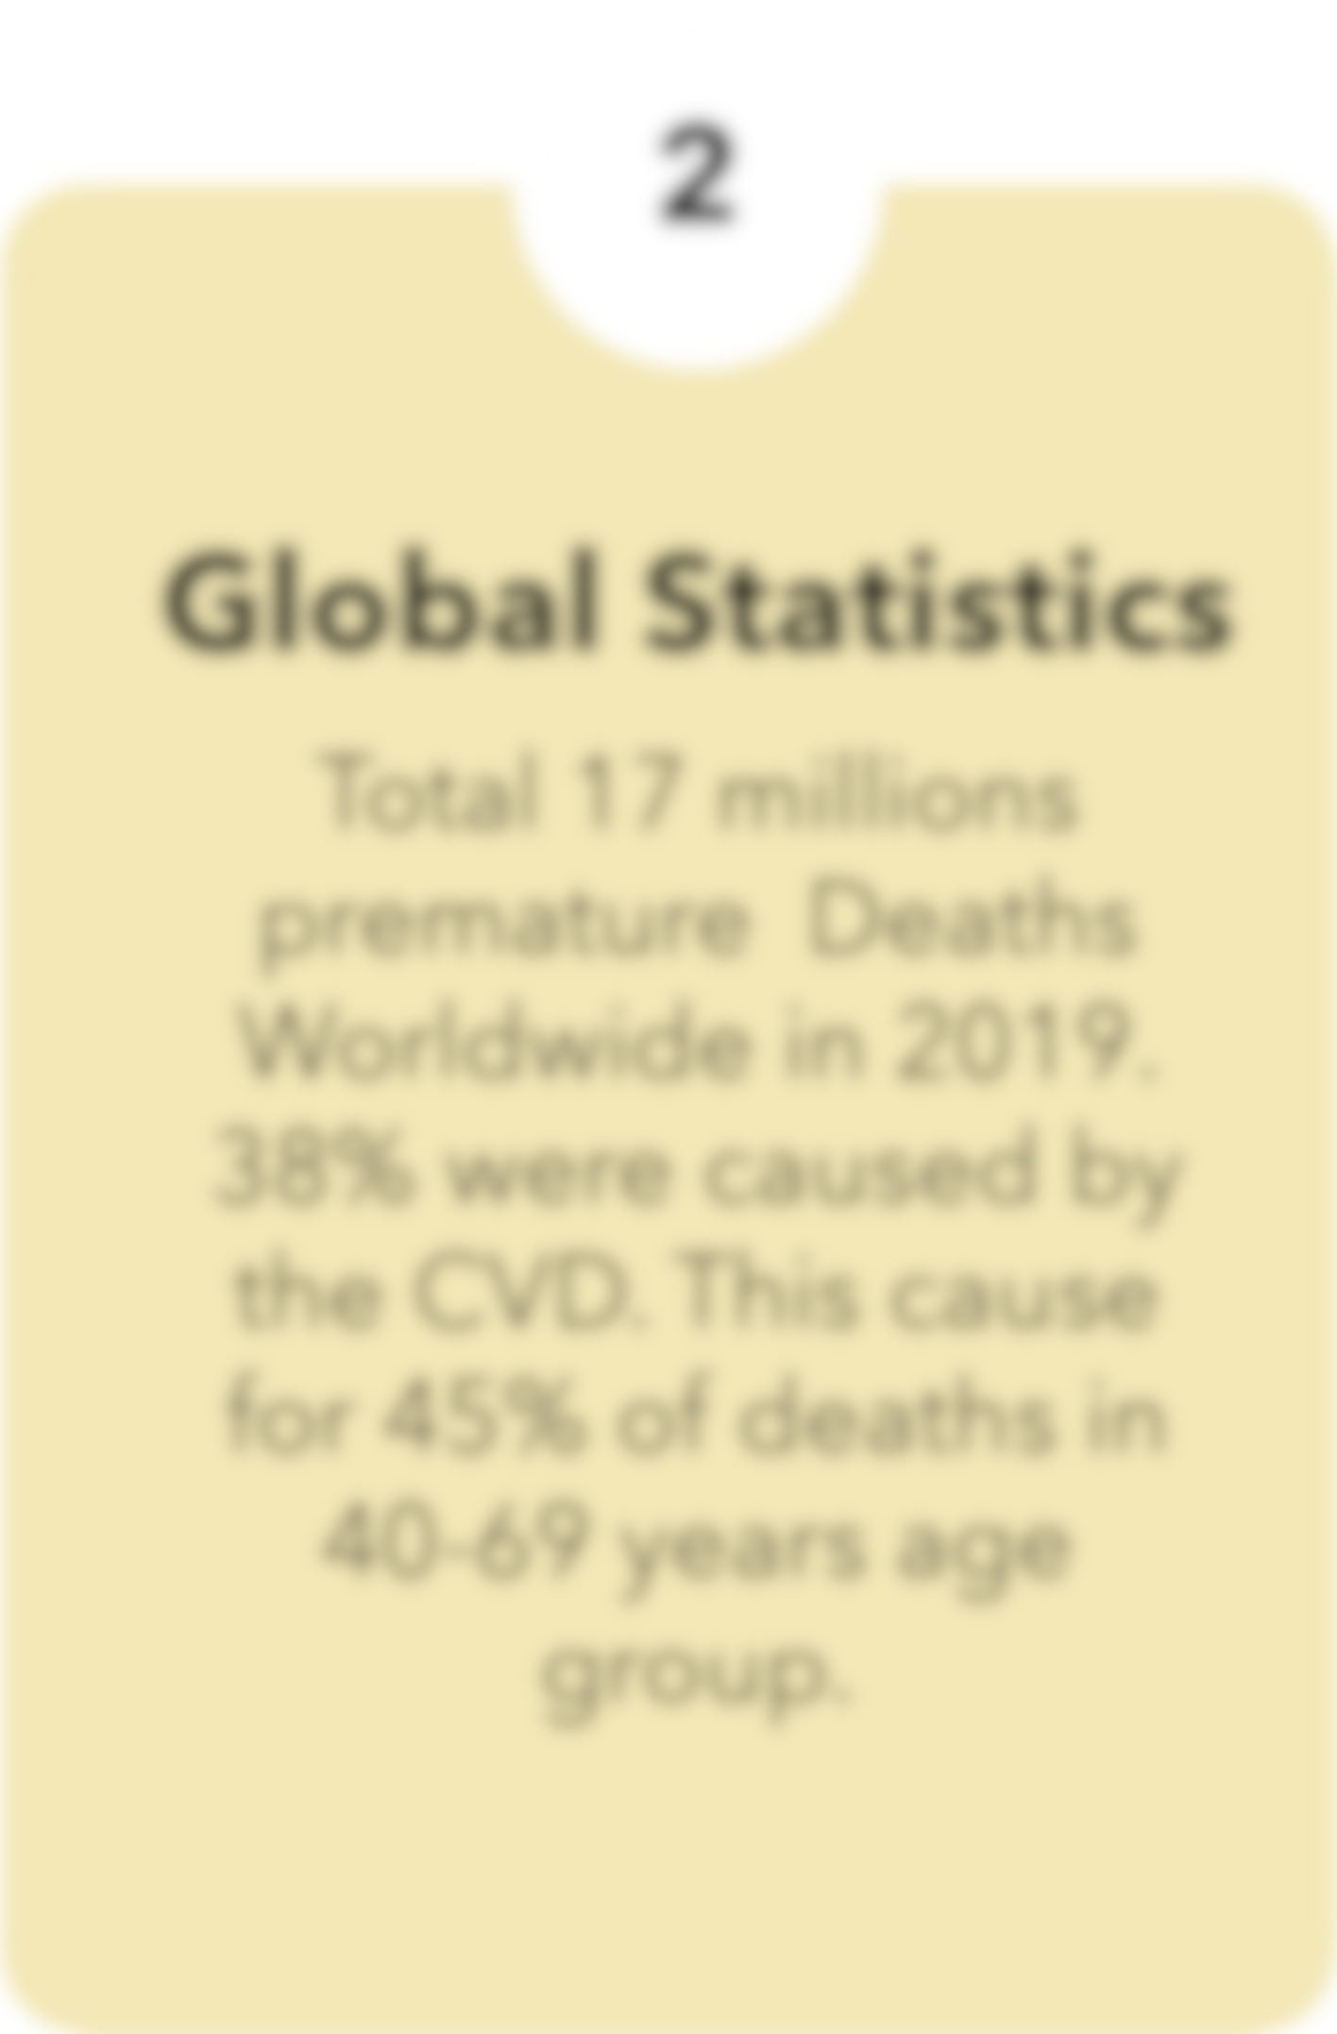



Predictive Modelling
Cardiovascular
FOR
Disease
Risk Assessment
Notes:
Welcome Sir This is

Slide 2

Notes:
Good Morning Sir, this is the most effective

Slide 3
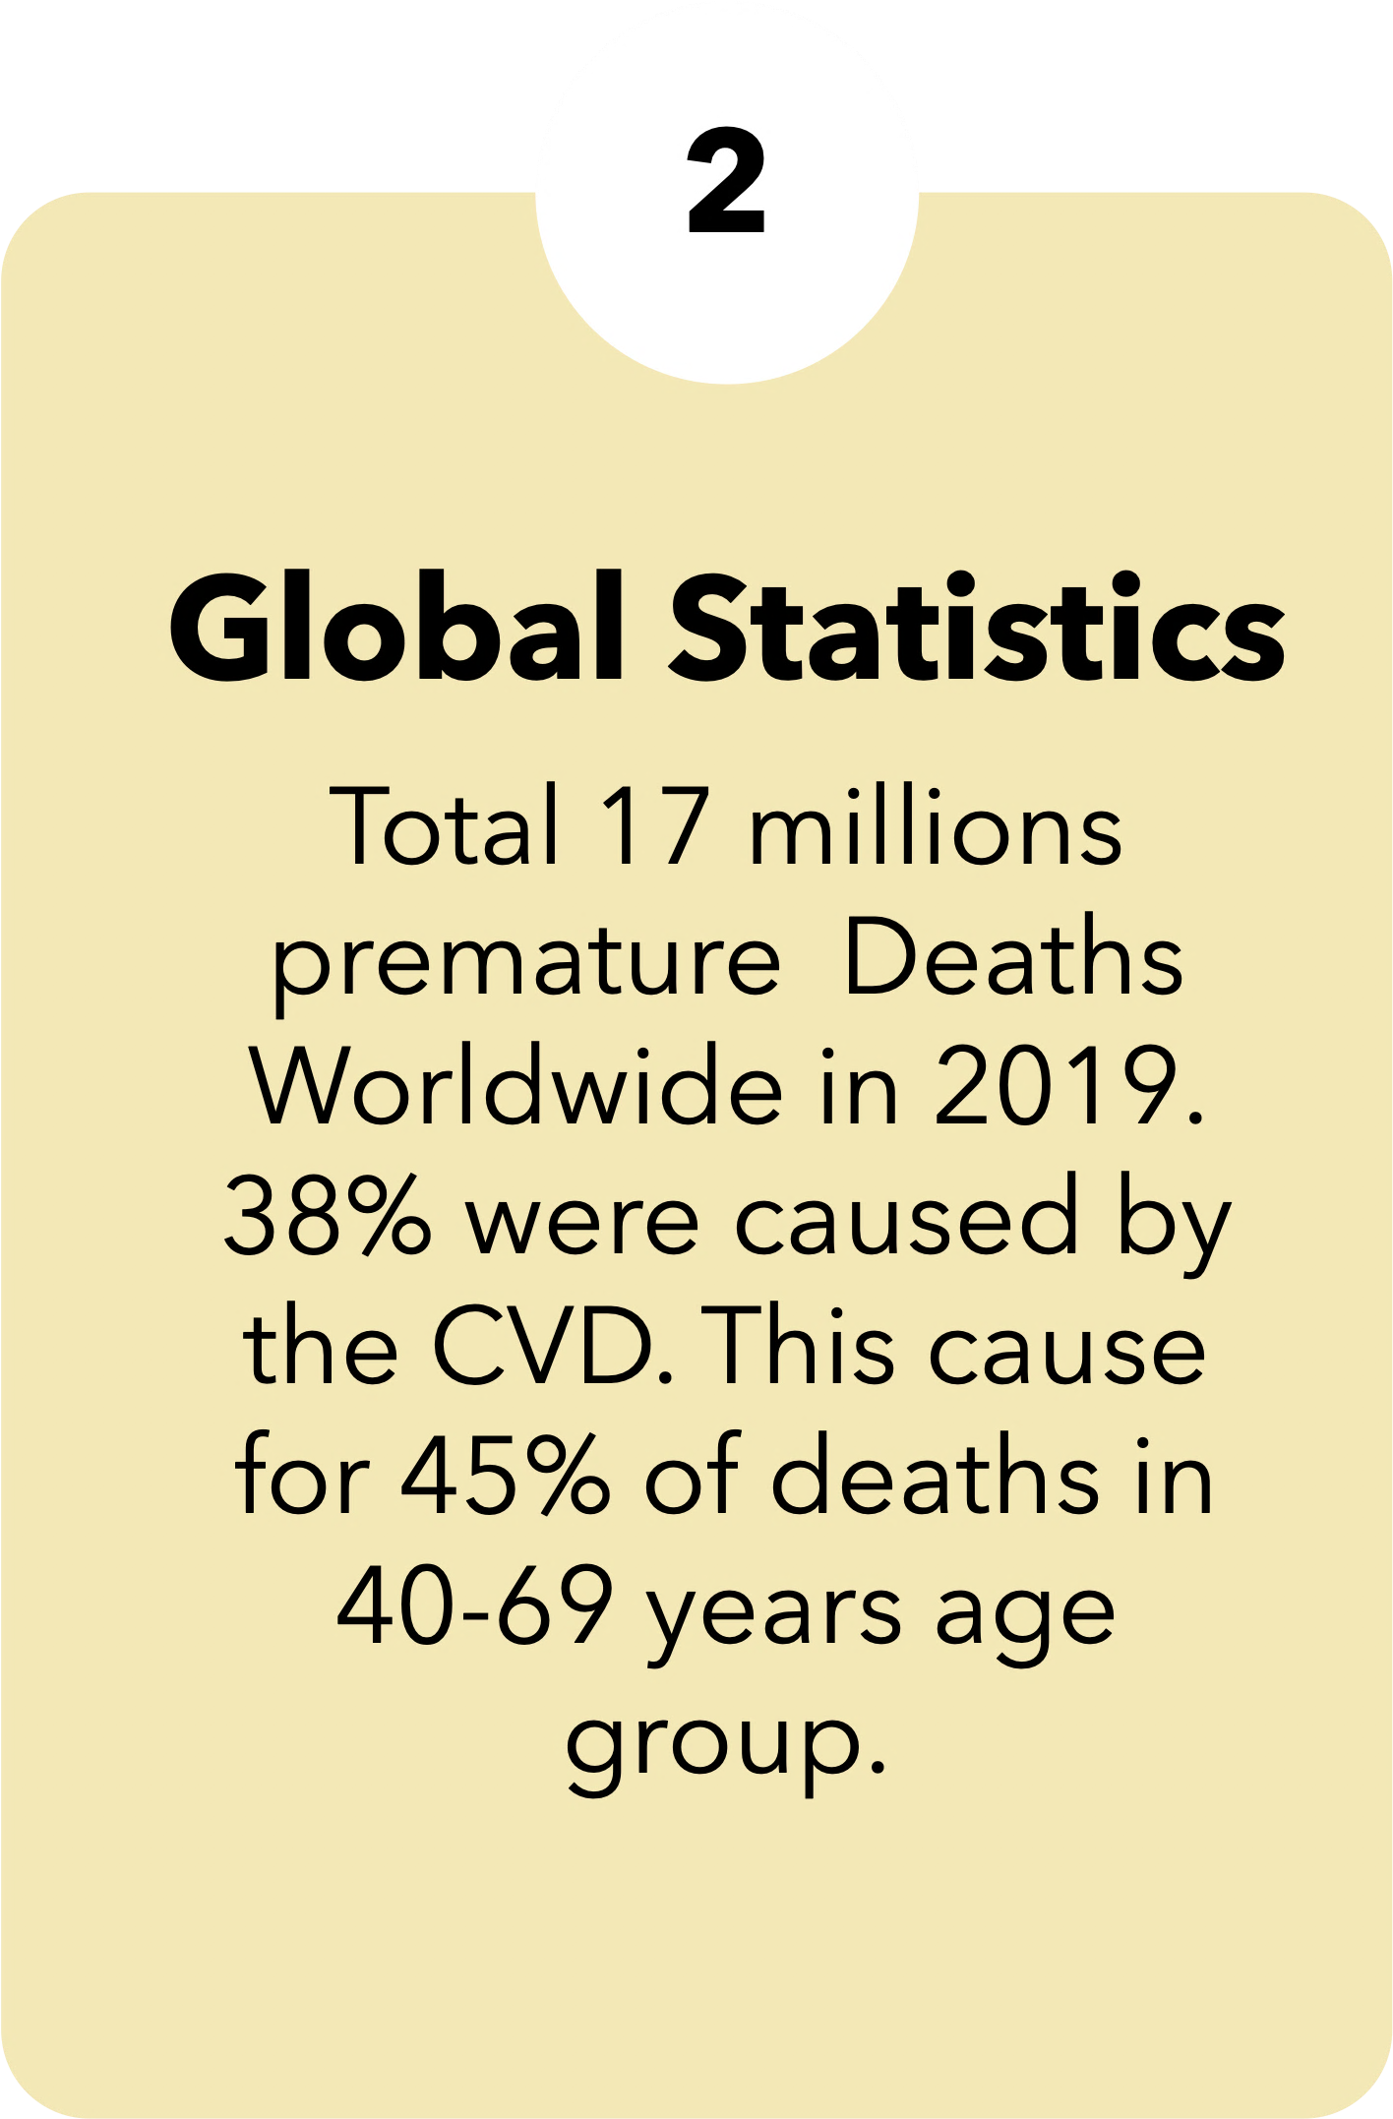


Slide 4
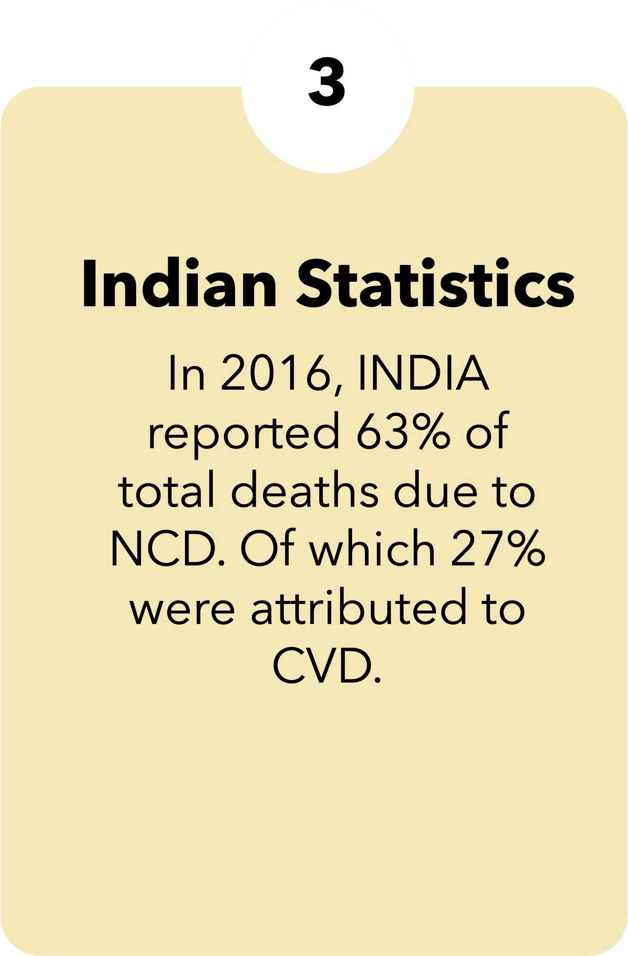
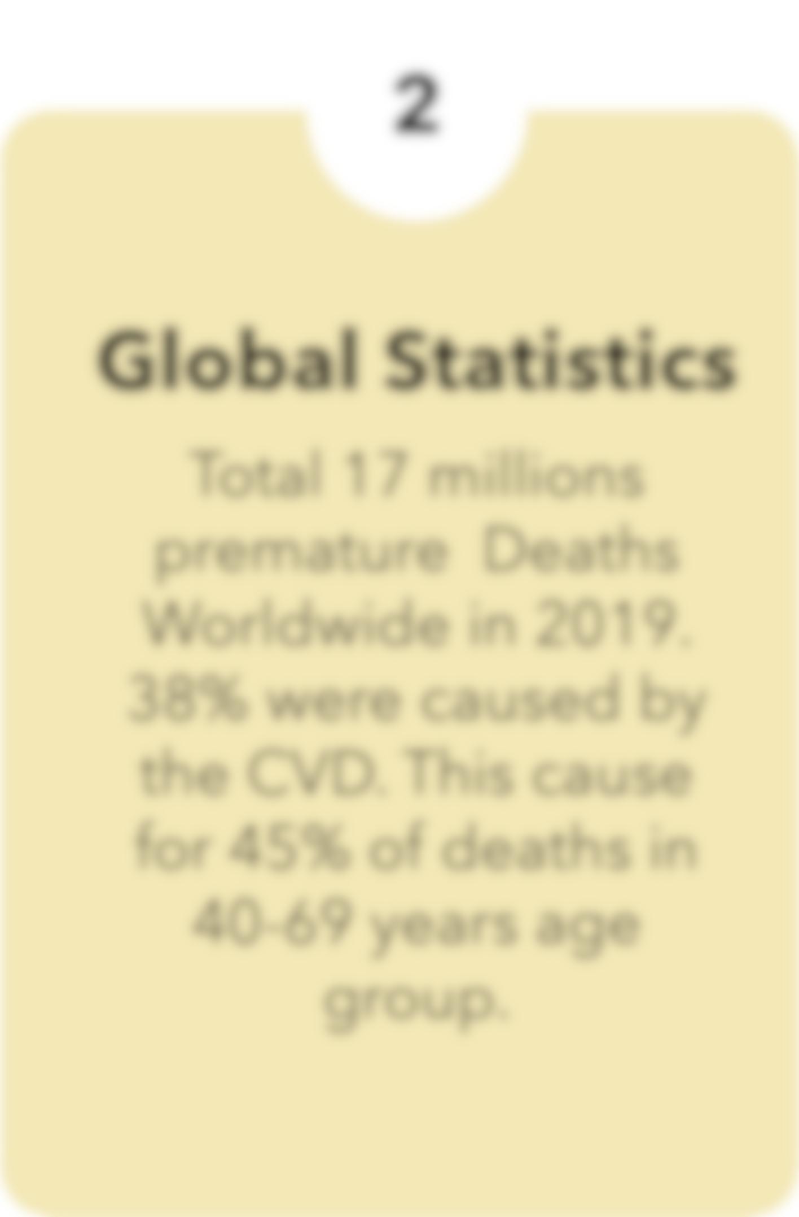

Scope and Objective
A
B
C
C
Investigate how lifestyle choices impact heart health and explore ways to reduce the risk of cardiovascular disease (CVD).
Evaluate the imp. of
early detection in preventing severe outcomes related to CVD.
Develop and test statistical models to identify individuals at high risk of developing CVD, aiding in timely intervention and prevention.
Provide actionable insights for healthcare prof. and policymakers to make strategies for reducing the global burden of CVD.

Slide 5

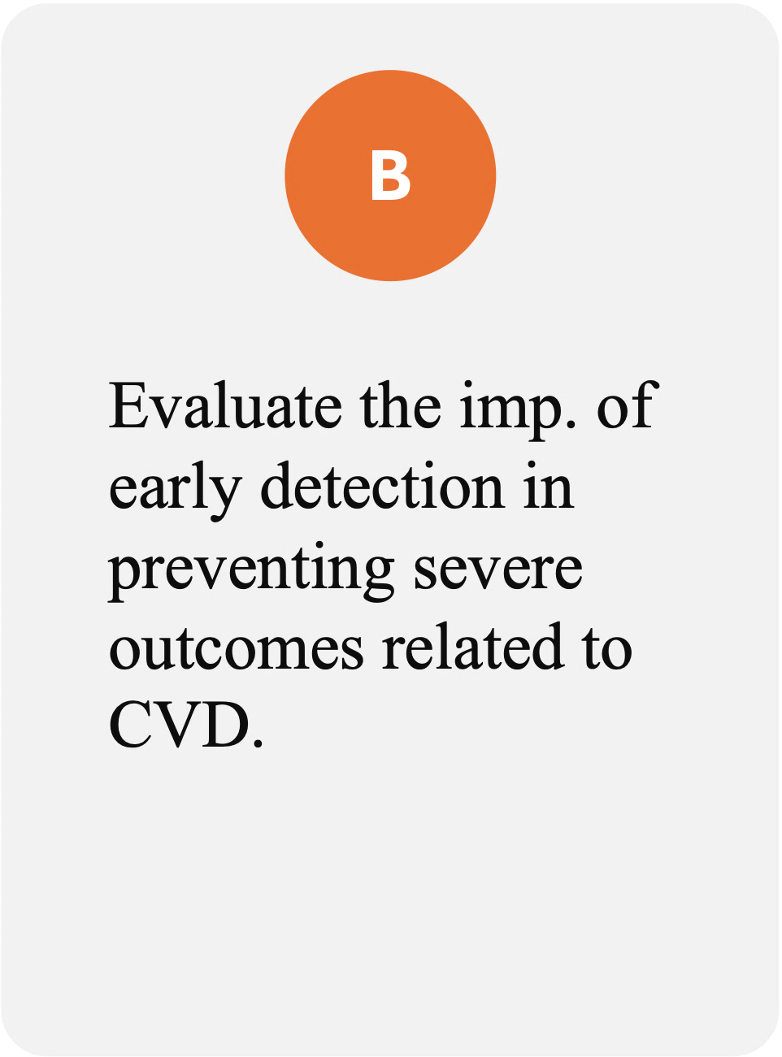
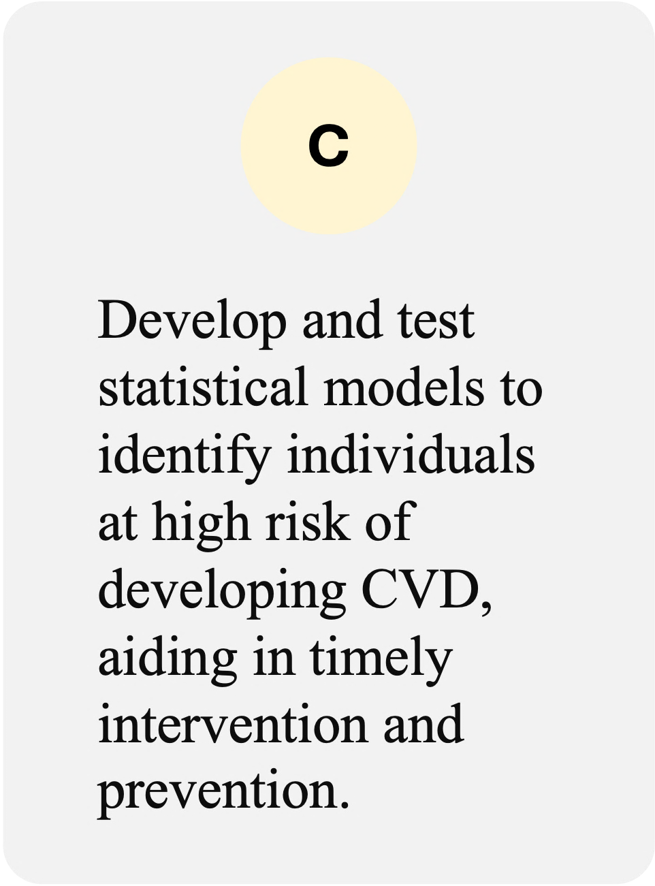

Scope and Objective

Slide 6
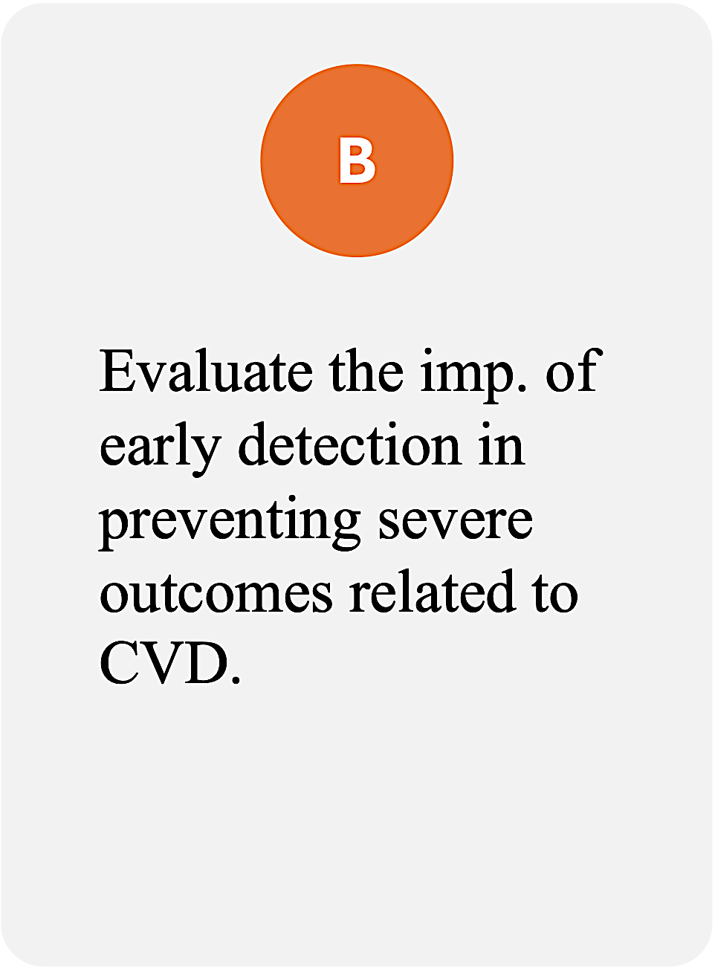


Scope and Objective

Slide 7
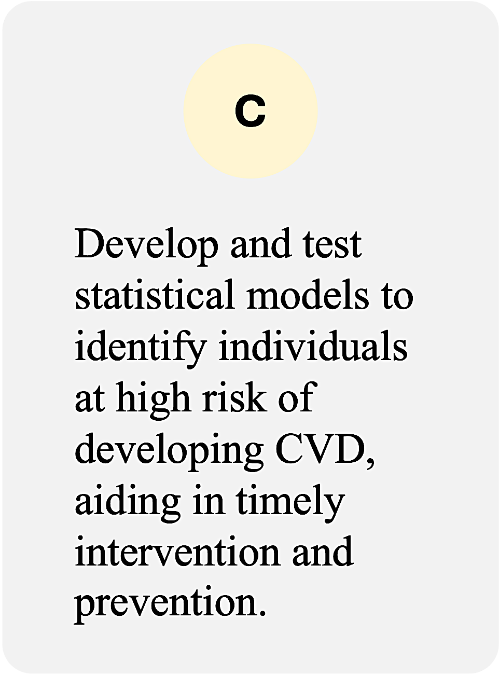
Scope and Objective

Slide 8

Assumption
Assumption
Scope and Objective
01
03
04
Assumption
Assumption
01
02
Logistic
02
Categories should be both mutually exclusive and exhaustive, meaning that each case can only belong to one group and every case must be a member of one of the groups .
In contrast to linear regression, Logistic Regression often demands larger sample sizes due to the reliance on maximum likelihood estimation. Which is based on approximations derived from large sample theory.
Regression
Logistic Regression doesn't Presuppose any linear relationship between the predictor and the response variable.
03
The response variable should exhibit a dichotomous nature, meaning it can be categorised into two distinct groups
04

Slide 9
Assumption
Assumption
01
04
03
Assumption
Assumption
01
02
Logistic
02
In contrast to linear regression, Logistic Regression often demands larger sample sizes due to the reliance on maximum likelihood estimation. Which is based on approximations derived from large sample theory.
Regression
Categories should be both mutually exclusive and exhaustive, meaning that each case can only belong to one group and every case must be a member of one of the groups .
Logistic Regression doesn't Presuppose any linear relationship between the predictor and the response variable.
03
The response variable should exhibit a dichotomous nature, meaning it can be categorised into two distinct groups
04

Slide 10
Assumption
Assumption
01
03
04
Assumption
Assumption
01
02
02
Categories should be both mutually exclusive and exhaustive, meaning that each case can only belong to one group and every case must be a member of one of the groups .
In contrast to linear regression, Logistic Regression often demands larger sample sizes due to the reliance on maximum likelihood estimation. Which is based on approximations derived from large sample theory.
Logistic Regression
Logistic Regression doesn't Presuppose any linear relationship between the predictor and the response variable.
03
The response variable should exhibit a dichotomous nature, meaning it can be categorised into two distinct groups
04

Slide 11
Assumption
Assumption
01
03
04
Assumption
Assumption
01
02
02
Categories should be both mutually exclusive and exhaustive, meaning that each case can only belong to one group and every case must be a member of one of the groups .
In contrast to linear regression, Logistic Regression often demands larger sample sizes due to the reliance on maximum likelihood estimation. Which is based on approximations derived from large sample theory.
Logistic Regression doesn't Presuppose any linear relationship between the predictor and the response variable.
Logistic Regression
The response variable should exhibit a dichotomous nature, meaning it can be categorised into two distinct groups
03
04

Slide 12
Assumption
Assumption
01
03
04
Assumption
Assumption
01
02
02
Categories should be both mutually exclusive and exhaustive, meaning that each case can only belong to one group and every case must be a member of one of the groups .
In contrast to linear regression, Logistic Regression often demands larger sample sizes due to the reliance on maximum likelihood estimation. Which is based on approximations derived from large sample theory.
Logistic Regression doesn't Presuppose any linear relationship between the predictor and the response variable.
Logistic Regression
The response variable should exhibit a dichotomous nature, meaning it can be categorised into two distinct groups
03
04

Slide 13
Assumption
Assumption
01
03
04
Assumption
Assumption
01
02
02
Categories should be both mutually exclusive and exhaustive, meaning that each case can only belong to one group and every case must be a member of one of the groups .
In contrast to linear regression, Logistic Regression often demands larger sample sizes due to the reliance on maximum likelihood estimation. Which is based on approximations derived from large sample theory.
Logistic Regression doesn't Presuppose any linear relationship between the predictor and the response variable.
Logistic Regression
The response variable should exhibit a dichotomous nature, meaning it can be categorised into two distinct groups
03
04

Slide 14




GETTING TO KNOW THE
DATASET
Glucose
Heart
Rate
BMI
DIAS BP
SYS BP
Diabetes
STROKE
BP
No. of
3657
Origin
Glucose
Heart
Rate
BMI
DIAS BP
Chol.
HYP
Cigs
CVD
No of Datapoints
Origin Of the Dataset
No of Datapoints
CHD - 10 Year Risk
Sex
Age
Education
Current Smoker
Cigs. Per Day
BP Meds
Prevalent Stroke
Prevalent Hypersensitivity
Diabetes
Total Cholesterol
Sys BP
Dia BP
BMI
Heart Rate
Glucose
In the Dataset, there are in total 3,657 data points available encompassing various demographic, behavioural, and medical risk factors.
This Cardiovascular Disease Dataset Dataset Was collected from the UCI Machine Learning Library
In the Dataset, there are in total 3,657 data points available encompassing various demographic, behavioural, and medical risk factors.
Binary Variables
Binary Variable indicating the presence (1) or absence(0) of CHD risk.
Categorical ( Nominal )
0 = Female , 1 = male
Continuous
Age in years
Categorical ( Nominal )
Denotes the Education Level of the individual.
1 : Pre-College Level
2 : Undergrad Level
3 : Postgrad Level
Categorical ( Nominal )
0 = Don’t Smoke , 1 = Smoke
Categorical ( Nominal )
0 = Don’t Smoke , 1 = Smoke
Categorical ( Nominal )
Specifies if the individual was using medication for blood pressure management..[ 0 = Not Diabetic , 1 = Diabetic ]
Categorical ( Nominal )
Identifies whether the patient has previously experienced a stroke. [ 0 = Haven’t , 1 = Have experienced ]
Categorical ( Nominal )
Indicates whether the patient is hypertensive [ 0 =Patient isn’t Hypersensitive,1=Patient is Hypersensitive ]
Categorical ( Nominal )
Identifies whether the patient has diabetes. [0 = Patient isn’t Diabetes , 1 = Patient is Diabetic ]
Continuous
Represents the total blood cholesterol level.
Continuous
Represents the systolic blood pressure level.
Continuous
Represents the Diastolic blood pressure level
Continuous
Represents the individual’s Body Mass Index
Continuous
Represents the heart rate treated as continuous due to the large number of possible values.
Continuous
Represents the heart rate treated as continuous due to the large number of possible values.

Slide 15
GETTING TO KNOW THE
DATASET
Glucose
Heart
Rate
BMI
DIAS BP
SYS BP
Chol.
Diabetes
STROKE
BP
No. of
3657
Origin
Glucose
Heart
Rate
BMI
DIAS BP
HYP
Cigs
CVD
No of Datapoints
Origin Of the Dataset
No of Datapoints
CHD - 10 Year Risk
Sex
Age
Education
Current Smoker
Cigs. Per Day
BP Meds
Prevalent Stroke
Prevalent Hypersensitivity
Diabetes
Total Cholesterol
Sys BP
Dia BP
BMI
Heart Rate
Glucose
In the Dataset, there are in total 3,657 data points available encompassing various demographic, behavioural, and medical risk factors.
This Cardiovascular Disease Dataset Dataset Was collected from the UCI Machine Learning Library
In the Dataset, there are in total 3,657 data points available encompassing various demographic, behavioural, and medical risk factors.
Binary Variables
Binary Variable indicating the presence (1) or absence(0) of CHD risk.
Categorical ( Nominal )
0 = Female , 1 = male
Continuous
Age in years
Categorical ( Nominal )
Denotes the Education Level of the individual.
1 : Pre-College Level
2 : Undergrad Level
3 : Postgrad Level
Categorical ( Nominal )
0 = Don’t Smoke , 1 = Smoke
Categorical ( Nominal )
0 = Don’t Smoke , 1 = Smoke
Categorical ( Nominal )
Specifies if the individual was using medication for blood pressure management..[ 0 = Not Diabetic , 1 = Diabetic ]
Categorical ( Nominal )
Identifies whether the patient has previously experienced a stroke. [ 0 = Haven’t , 1 = Have experienced ]
Categorical ( Nominal )
Indicates whether the patient is hypertensive [ 0 =Patient isn’t Hypersensitive,1=Patient is Hypersensitive ]
Categorical ( Nominal )
Identifies whether the patient has diabetes. [0 = Patient isn’t Diabetes , 1 = Patient is Diabetic ]
Continuous
Represents the total blood cholesterol level.
Continuous
Represents the systolic blood pressure level.
Continuous
Represents the Diastolic blood pressure level
Continuous
Represents the individual’s Body Mass Index
Continuous
Represents the heart rate treated as continuous due to the large number of possible values.
Continuous
Represents the heart rate treated as continuous due to the large number of possible values.
Response Variable

Slide 16
Response
Variable
GETTING TO KNOW THE
DATASET
Glucose
Heart
Rate
BMI
DIAS BP
SYS BP
Chol.
Diabetes
STROKE
BP
No. of
3657
Origin
Glucose
Heart
Rate
BMI
DIAS BP
HYP
Cigs
CVD
No of Datapoints
Origin Of the Dataset
No of Datapoints
CHD - 10 Year Risk
Sex
Age
Education
Current Smoker
Cigs. Per Day
BP Meds
Prevalent Stroke
Prevalent Hypersensitivity
Diabetes
Total Cholesterol
Sys BP
Dia BP
BMI
Heart Rate
Glucose
In the Dataset, there are in total 3,657 data points available encompassing various demographic, behavioural, and medical risk factors.
This Cardiovascular Disease Dataset Dataset Was collected from the UCI Machine Learning Library
In the Dataset, there are in total 3,657 data points available encompassing various demographic, behavioural, and medical risk factors.
Binary Variables
Binary Variable indicating the presence (1) or absence(0) of CHD risk.
Categorical ( Nominal )
0 = Female , 1 = male
Continuous
Age in years
Categorical ( Nominal )
Denotes the Education Level of the individual.
1 : Pre-College Level
2 : Undergrad Level
3 : Postgrad Level
Categorical ( Nominal )
0 = Don’t Smoke , 1 = Smoke
Categorical ( Nominal )
0 = Don’t Smoke , 1 = Smoke
Categorical ( Nominal )
Specifies if the individual was using medication for blood pressure management..[ 0 = Not Diabetic , 1 = Diabetic ]
Categorical ( Nominal )
Identifies whether the patient has previously experienced a stroke. [ 0 = Haven’t , 1 = Have experienced ]
Categorical ( Nominal )
Indicates whether the patient is hypertensive [ 0 =Patient isn’t Hypersensitive,1=Patient is Hypersensitive ]
Categorical ( Nominal )
Identifies whether the patient has diabetes. [0 = Patient isn’t Diabetes , 1 = Patient is Diabetic ]
Continuous
Represents the total blood cholesterol level.
Continuous
Represents the systolic blood pressure level.
Continuous
Represents the Diastolic blood pressure level
Continuous
Represents the individual’s Body Mass Index
Continuous
Represents the heart rate treated as continuous due to the large number of possible values.
Continuous
Represents the heart rate treated as continuous due to the large number of possible values.

Slide 17
Demographic
Factor
GETTING TO KNOW THE
DATASET
Glucose
Heart
Rate
BMI
DIAS BP
SYS BP
Chol.
Diabetes
STROKE
BP
No. of
3657
Origin
Glucose
Heart
Rate
BMI
DIAS BP
HYP
Cigs
CVD
No of Datapoints
Origin Of the Dataset
No of Datapoints
CHD - 10 Year Risk
Sex
Age
Education
Current Smoker
Cigs. Per Day
BP Meds
Prevalent Stroke
Prevalent Hypersensitivity
Diabetes
Total Cholesterol
Sys BP
Dia BP
BMI
Heart Rate
Glucose
In the Dataset, there are in total 3,657 data points available encompassing various demographic, behavioural, and medical risk factors.
This Cardiovascular Disease Dataset Dataset Was collected from the UCI Machine Learning Library
In the Dataset, there are in total 3,657 data points available encompassing various demographic, behavioural, and medical risk factors.
Binary Variables
Binary Variable indicating the presence (1) or absence(0) of CHD risk.
Categorical ( Nominal )
0 = Female , 1 = male
Continuous
Age in years
Categorical ( Nominal )
Denotes the Education Level of the individual.
1 : Pre-College Level
2 : Undergrad Level
3 : Postgrad Level
Categorical ( Nominal )
0 = Don’t Smoke , 1 = Smoke
Categorical ( Nominal )
0 = Don’t Smoke , 1 = Smoke
Categorical ( Nominal )
Specifies if the individual was using medication for blood pressure management..[ 0 = Not Diabetic , 1 = Diabetic ]
Categorical ( Nominal )
Identifies whether the patient has previously experienced a stroke. [ 0 = Haven’t , 1 = Have experienced ]
Categorical ( Nominal )
Indicates whether the patient is hypertensive [ 0 =Patient isn’t Hypersensitive,1=Patient is Hypersensitive ]
Categorical ( Nominal )
Identifies whether the patient has diabetes. [0 = Patient isn’t Diabetes , 1 = Patient is Diabetic ]
Continuous
Represents the total blood cholesterol level.
Continuous
Represents the systolic blood pressure level.
Continuous
Represents the Diastolic blood pressure level
Continuous
Represents the individual’s Body Mass Index
Continuous
Represents the heart rate treated as continuous due to the large number of possible values.
Continuous
Represents the heart rate treated as continuous due to the large number of possible values.

Slide 18
Demographic
Factor
GETTING TO KNOW THE
DATASET
Glucose
Heart
Rate
BMI
DIAS BP
SYS BP
STROKE
BP
No. of
3657
Origin
Glucose
Heart
Rate
BMI
DIAS BP
Chol.
Diabetes
HYP
Cigs
CVD
No of Datapoints
Origin Of the Dataset
No of Datapoints
CHD - 10 Year Risk
Sex
Age
Education
Current Smoker
Cigs. Per Day
BP Meds
Prevalent Stroke
Prevalent Hypersensitivity
Diabetes
Total Cholesterol
Sys BP
Dia BP
BMI
Heart Rate
Glucose
In the Dataset, there are in total 3,657 data points available encompassing various demographic, behavioural, and medical risk factors.
This Cardiovascular Disease Dataset Dataset Was collected from the UCI Machine Learning Library
In the Dataset, there are in total 3,657 data points available encompassing various demographic, behavioural, and medical risk factors.
Binary Variables
Binary Variable indicating the presence (1) or absence(0) of CHD risk.
Categorical ( Nominal )
0 = Female , 1 = male
Continuous
Age in years
Categorical ( Nominal )
Denotes the Education Level of the individual.
1 : Pre-College Level
2 : Undergrad Level
3 : Postgrad Level
Categorical ( Nominal )
0 = Don’t Smoke , 1 = Smoke
Categorical ( Nominal )
0 = Don’t Smoke , 1 = Smoke
Categorical ( Nominal )
Specifies if the individual was using medication for blood pressure management..[ 0 = Not Diabetic , 1 = Diabetic ]
Categorical ( Nominal )
Identifies whether the patient has previously experienced a stroke. [ 0 = Haven’t , 1 = Have experienced ]
Categorical ( Nominal )
Indicates whether the patient is hypertensive [ 0 =Patient isn’t Hypersensitive,1=Patient is Hypersensitive ]
Categorical ( Nominal )
Identifies whether the patient has diabetes. [0 = Patient isn’t Diabetes , 1 = Patient is Diabetic ]
Continuous
Represents the total blood cholesterol level.
Continuous
Represents the systolic blood pressure level.
Continuous
Represents the Diastolic blood pressure level
Continuous
Represents the individual’s Body Mass Index
Continuous
Represents the heart rate treated as continuous due to the large number of possible values.
Continuous
Represents the heart rate treated as continuous due to the large number of possible values.

Slide 19
Demographic
Factor
GETTING TO KNOW THE
DATASET
Glucose
Heart
Rate
BMI
DIAS BP
SYS BP
Chol.
Diabetes
HYP
STROKE
BP
No. of
CVD
No
Origin
Glucose
Heart
Rate
BMI
DIAS BP
Cigs
No of Datapoints
Origin Of the Dataset
No of Datapoints
CHD - 10 Year Risk
Sex
Age
Education
Current Smoker
Cigs. Per Day
BP Meds
Prevalent Stroke
Prevalent Hypersensitivity
Diabetes
Total Cholesterol
Sys BP
Dia BP
BMI
Heart Rate
Glucose
In the Dataset, there are in total 3,657 data points available encompassing various demographic, behavioural, and medical risk factors.
This Cardiovascular Disease Dataset Dataset Was collected from the UCI Machine Learning Library
In the Dataset, there are in total 3,657 data points available encompassing various demographic, behavioural, and medical risk factors.
Binary Variables
Binary Variable indicating the presence (1) or absence(0) of CHD risk.
Categorical ( Nominal )
0 = Female , 1 = male
Continuous
Age in years
Categorical ( Nominal )
Denotes the Education Level of the individual.
1 : Pre-College Level
2 : Undergrad Level
3 : Postgrad Level
Categorical ( Nominal )
0 = Don’t Smoke , 1 = Smoke
Categorical ( Nominal )
0 = Don’t Smoke , 1 = Smoke
Categorical ( Nominal )
Specifies if the individual was using medication for blood pressure management..[ 0 = Not Diabetic , 1 = Diabetic ]
Categorical ( Nominal )
Identifies whether the patient has previously experienced a stroke. [ 0 = Haven’t , 1 = Have experienced ]
Categorical ( Nominal )
Indicates whether the patient is hypertensive [ 0 =Patient isn’t Hypersensitive,1=Patient is Hypersensitive ]
Categorical ( Nominal )
Identifies whether the patient has diabetes. [0 = Patient isn’t Diabetes , 1 = Patient is Diabetic ]
Continuous
Represents the total blood cholesterol level.
Continuous
Represents the systolic blood pressure level.
Continuous
Represents the Diastolic blood pressure level
Continuous
Represents the individual’s Body Mass Index
Continuous
Represents the heart rate treated as continuous due to the large number of possible values.
Continuous
Represents the heart rate treated as continuous due to the large number of possible values.

Slide 20
Behavioral
Factor
GETTING TO KNOW THE
DATASET
Glucose
Heart
Rate
BMI
DIAS BP
SYS BP
Chol.
Diabetes
HYP
STROKE
BP
No. of
CVD
No
Origin
Glucose
Heart
Rate
BMI
DIAS BP
Cigs
No of Datapoints
Origin Of the Dataset
No of Datapoints
CHD - 10 Year Risk
Sex
Age
Education
Current Smoker
Cigs. Per Day
BP Meds
Prevalent Stroke
Prevalent Hypersensitivity
Diabetes
Total Cholesterol
Sys BP
Dia BP
BMI
Heart Rate
Glucose
In the Dataset, there are in total 3,657 data points available encompassing various demographic, behavioural, and medical risk factors.
This Cardiovascular Disease Dataset Dataset Was collected from the UCI Machine Learning Library
In the Dataset, there are in total 3,657 data points available encompassing various demographic, behavioural, and medical risk factors.
Binary Variables
Binary Variable indicating the presence (1) or absence(0) of CHD risk.
Categorical ( Nominal )
0 = Female , 1 = male
Continuous
Age in years
Categorical ( Nominal )
Denotes the Education Level of the individual.
1 : Pre-College Level
2 : Undergrad Level
3 : Postgrad Level
Categorical ( Nominal )
0 = Don’t Smoke , 1 = Smoke
Categorical ( Nominal )
0 = Don’t Smoke , 1 = Smoke
Categorical ( Nominal )
Specifies if the individual was using medication for blood pressure management..[ 0 = Not Diabetic , 1 = Diabetic ]
Categorical ( Nominal )
Identifies whether the patient has previously experienced a stroke. [ 0 = Haven’t , 1 = Have experienced ]
Categorical ( Nominal )
Indicates whether the patient is hypertensive [ 0 =Patient isn’t Hypersensitive,1=Patient is Hypersensitive ]
Categorical ( Nominal )
Identifies whether the patient has diabetes. [0 = Patient isn’t Diabetes , 1 = Patient is Diabetic ]
Continuous
Represents the total blood cholesterol level.
Continuous
Represents the systolic blood pressure level.
Continuous
Represents the Diastolic blood pressure level
Continuous
Represents the individual’s Body Mass Index
Continuous
Represents the heart rate treated as continuous due to the large number of possible values.
Continuous
Represents the heart rate treated as continuous due to the large number of possible values.

Slide 21
Behavioral
Factor
GETTING TO KNOW THE
DATASET
Glucose
Heart
Rate
BMI
DIAS BP
SYS BP
Chol.
Diabetes
HYP
STROKE
BP
No. of
CVD
No
Origin
Glucose
Heart
Rate
BMI
DIAS BP
Cigs
No of Datapoints
Origin Of the Dataset
No of Datapoints
CHD - 10 Year Risk
Sex
Age
Education
Current Smoker
Cigs. Per Day
BP Meds
Prevalent Stroke
Prevalent Hypersensitivity
Diabetes
Total Cholesterol
Sys BP
Dia BP
BMI
Heart Rate
Glucose
In the Dataset, there are in total 3,657 data points available encompassing various demographic, behavioural, and medical risk factors.
This Cardiovascular Disease Dataset Dataset Was collected from the UCI Machine Learning Library
In the Dataset, there are in total 3,657 data points available encompassing various demographic, behavioural, and medical risk factors.
Binary Variables
Binary Variable indicating the presence (1) or absence(0) of CHD risk.
Categorical ( Nominal )
0 = Female , 1 = male
Continuous
Age in years
Categorical ( Nominal )
Denotes the Education Level of the individual.
1 : Pre-College Level
2 : Undergrad Level
3 : Postgrad Level
Categorical ( Nominal )
0 = Don’t Smoke , 1 = Smoke
Categorical ( Nominal )
0 = Don’t Smoke , 1 = Smoke
Categorical ( Nominal )
Specifies if the individual was using medication for blood pressure management..[ 0 = Not Diabetic , 1 = Diabetic ]
Categorical ( Nominal )
Identifies whether the patient has previously experienced a stroke. [ 0 = Haven’t , 1 = Have experienced ]
Categorical ( Nominal )
Indicates whether the patient is hypertensive [ 0 =Patient isn’t Hypersensitive,1=Patient is Hypersensitive ]
Categorical ( Nominal )
Identifies whether the patient has diabetes. [0 = Patient isn’t Diabetes , 1 = Patient is Diabetic ]
Continuous
Represents the total blood cholesterol level.
Continuous
Represents the systolic blood pressure level.
Continuous
Represents the Diastolic blood pressure level
Continuous
Represents the individual’s Body Mass Index
Continuous
Represents the heart rate treated as continuous due to the large number of possible values.
Continuous
Represents the heart rate treated as continuous due to the large number of possible values.

Slide 22
Medical
History
GETTING TO KNOW THE
DATASET
Glucose
Heart
Rate
BMI
DIAS BP
SYS BP
Chol.
Diabetes
HYP
STROKE
BP
No. of
CVD
No
Origin
Glucose
Heart
Rate
BMI
DIAS BP
Cigs
No of Datapoints
Origin Of the Dataset
No of Datapoints
CHD - 10 Year Risk
Sex
Age
Education
Current Smoker
Cigs. Per Day
BP Meds
Prevalent Stroke
Prevalent Hypersensitivity
Diabetes
Total Cholesterol
Sys BP
Dia BP
BMI
Heart Rate
Glucose
In the Dataset, there are in total 3,657 data points available encompassing various demographic, behavioural, and medical risk factors.
This Cardiovascular Disease Dataset Dataset Was collected from the UCI Machine Learning Library
In the Dataset, there are in total 3,657 data points available encompassing various demographic, behavioural, and medical risk factors.
Binary Variables
Binary Variable indicating the presence (1) or absence(0) of CHD risk.
Categorical ( Nominal )
0 = Female , 1 = male
Continuous
Age in years
Categorical ( Nominal )
Denotes the Education Level of the individual.
1 : Pre-College Level
2 : Undergrad Level
3 : Postgrad Level
Categorical ( Nominal )
0 = Don’t Smoke , 1 = Smoke
Categorical ( Nominal )
0 = Don’t Smoke , 1 = Smoke
Categorical ( Nominal )
Specifies if the individual was using medication for blood pressure management..[ 0 = Not Diabetic , 1 = Diabetic ]
Categorical ( Nominal )
Identifies whether the patient has previously experienced a stroke. [ 0 = Haven’t , 1 = Have experienced ]
Categorical ( Nominal )
Indicates whether the patient is hypertensive [ 0 =Patient isn’t Hypersensitive,1=Patient is Hypersensitive ]
Categorical ( Nominal )
Identifies whether the patient has diabetes. [0 = Patient isn’t Diabetes , 1 = Patient is Diabetic ]
Continuous
Represents the total blood cholesterol level.
Continuous
Represents the systolic blood pressure level.
Continuous
Represents the Diastolic blood pressure level
Continuous
Represents the individual’s Body Mass Index
Continuous
Represents the heart rate treated as continuous due to the large number of possible values.
Continuous
Represents the heart rate treated as continuous due to the large number of possible values.

Slide 23
Medical
History
GETTING TO KNOW THE
DATASET
Glucose
Heart
Rate
BMI
DIAS BP
SYS BP
Chol.
Diabetes
HYP
STROKE
BP
No. of
CVD
No
Origin
Glucose
Heart
Rate
BMI
DIAS BP
Cigs
No of Datapoints
Origin Of the Dataset
No of Datapoints
CHD - 10 Year Risk
Sex
Age
Education
Current Smoker
Cigs. Per Day
BP Meds
Prevalent Stroke
Prevalent Hypersensitivity
Diabetes
Total Cholesterol
Sys BP
Dia BP
BMI
Heart Rate
Glucose
In the Dataset, there are in total 3,657 data points available encompassing various demographic, behavioural, and medical risk factors.
This Cardiovascular Disease Dataset Dataset Was collected from the UCI Machine Learning Library
In the Dataset, there are in total 3,657 data points available encompassing various demographic, behavioural, and medical risk factors.
Binary Variables
Binary Variable indicating the presence (1) or absence(0) of CHD risk.
Categorical ( Nominal )
0 = Female , 1 = male
Continuous
Age in years
Categorical ( Nominal )
Denotes the Education Level of the individual.
1 : Pre-College Level
2 : Undergrad Level
3 : Postgrad Level
Categorical ( Nominal )
0 = Don’t Smoke , 1 = Smoke
Categorical ( Nominal )
0 = Don’t Smoke , 1 = Smoke
Categorical ( Nominal )
Specifies if the individual was using medication for blood pressure management..[ 0 = Not Diabetic , 1 = Diabetic ]
Categorical ( Nominal )
Identifies whether the patient has previously experienced a stroke. [ 0 = Haven’t , 1 = Have experienced ]
Categorical ( Nominal )
Indicates whether the patient is hypertensive [ 0 =Patient isn’t Hypersensitive,1=Patient is Hypersensitive ]
Categorical ( Nominal )
Identifies whether the patient has diabetes. [0 = Patient isn’t Diabetes , 1 = Patient is Diabetic ]
Continuous
Represents the total blood cholesterol level.
Continuous
Represents the systolic blood pressure level.
Continuous
Represents the Diastolic blood pressure level
Continuous
Represents the individual’s Body Mass Index
Continuous
Represents the heart rate treated as continuous due to the large number of possible values.
Continuous
Represents the heart rate treated as continuous due to the large number of possible values.

Slide 24
Medical
History
GETTING TO KNOW THE
DATASET
Glucose
Heart
Rate
BMI
DIAS BP
SYS BP
Chol.
Diabetes
HYP
STROKE
BP
No. of
CVD
No
Origin
Glucose
Heart
Rate
BMI
DIAS BP
Cigs
No of Datapoints
Origin Of the Dataset
No of Datapoints
CHD - 10 Year Risk
Sex
Age
Education
Current Smoker
Cigs. Per Day
BP Meds
Prevalent Stroke
Prevalent Hypersensitivity
Diabetes
Total Cholesterol
Sys BP
Dia BP
BMI
Heart Rate
Glucose
In the Dataset, there are in total 3,657 data points available encompassing various demographic, behavioural, and medical risk factors.
This Cardiovascular Disease Dataset Dataset Was collected from the UCI Machine Learning Library
In the Dataset, there are in total 3,657 data points available encompassing various demographic, behavioural, and medical risk factors.
Binary Variables
Binary Variable indicating the presence (1) or absence(0) of CHD risk.
Categorical ( Nominal )
0 = Female , 1 = male
Continuous
Age in years
Categorical ( Nominal )
Denotes the Education Level of the individual.
1 : Pre-College Level
2 : Undergrad Level
3 : Postgrad Level
Categorical ( Nominal )
0 = Don’t Smoke , 1 = Smoke
Categorical ( Nominal )
0 = Don’t Smoke , 1 = Smoke
Categorical ( Nominal )
Specifies if the individual was using medication for blood pressure management..[ 0 = Not Diabetic , 1 = Diabetic ]
Categorical ( Nominal )
Identifies whether the patient has previously experienced a stroke. [ 0 = Haven’t , 1 = Have experienced ]
Categorical ( Nominal )
Indicates whether the patient is hypertensive [ 0 =Patient isn’t Hypersensitive,1=Patient is Hypersensitive ]
Categorical ( Nominal )
Identifies whether the patient has diabetes. [0 = Patient isn’t Diabetes , 1 = Patient is Diabetic ]
Continuous
Represents the total blood cholesterol level.
Continuous
Represents the systolic blood pressure level.
Continuous
Represents the Diastolic blood pressure level
Continuous
Represents the individual’s Body Mass Index
Continuous
Represents the heart rate treated as continuous due to the large number of possible values.
Continuous
Represents the heart rate treated as continuous due to the large number of possible values.

Slide 25
Medical
History
GETTING TO KNOW THE
DATASET
Glucose
Heart
Rate
BMI
DIAS BP
SYS BP
Chol.
Diabetes
HYP
STROKE
BP
No. of
CVD
No
Origin
Glucose
Heart
Rate
BMI
DIAS BP
Cigs
No of Datapoints
Origin Of the Dataset
No of Datapoints
CHD - 10 Year Risk
Sex
Age
Education
Current Smoker
Cigs. Per Day
BP Meds
Prevalent Stroke
Prevalent Hypersensitivity
Diabetes
Total Cholesterol
Sys BP
Dia BP
BMI
Heart Rate
Glucose
In the Dataset, there are in total 3,657 data points available encompassing various demographic, behavioural, and medical risk factors.
This Cardiovascular Disease Dataset Dataset Was collected from the UCI Machine Learning Library
In the Dataset, there are in total 3,657 data points available encompassing various demographic, behavioural, and medical risk factors.
Binary Variables
Binary Variable indicating the presence (1) or absence(0) of CHD risk.
Categorical ( Nominal )
0 = Female , 1 = male
Continuous
Age in years
Categorical ( Nominal )
Denotes the Education Level of the individual.
1 : Pre-College Level
2 : Undergrad Level
3 : Postgrad Level
Categorical ( Nominal )
0 = Don’t Smoke , 1 = Smoke
Categorical ( Nominal )
0 = Don’t Smoke , 1 = Smoke
Categorical ( Nominal )
Specifies if the individual was using medication for blood pressure management..[ 0 = Not Diabetic , 1 = Diabetic ]
Categorical ( Nominal )
Identifies whether the patient has previously experienced a stroke. [ 0 = Haven’t , 1 = Have experienced ]
Categorical ( Nominal )
Indicates whether the patient is hypertensive [ 0 =Patient isn’t Hypersensitive,1=Patient is Hypersensitive ]
Categorical ( Nominal )
Identifies whether the patient has diabetes. [0 = Patient isn’t Diabetes , 1 = Patient is Diabetic ]
Continuous
Represents the total blood cholesterol level.
Continuous
Represents the systolic blood pressure level.
Continuous
Represents the Diastolic blood pressure level
Continuous
Represents the individual’s Body Mass Index
Continuous
Represents the heart rate treated as continuous due to the large number of possible values.
Continuous
Represents the heart rate treated as continuous due to the large number of possible values.

Slide 26
Medical
History
GETTING TO KNOW THE
DATASET
Glucose
Heart
Rate
BMI
DIAS BP
SYS BP
Chol.
Diabetes
HYP
STROKE
BP
No. of
CVD
No
Origin
Glucose
Heart
Rate
BMI
DIAS BP
Cigs
No of Datapoints
Origin Of the Dataset
No of Datapoints
CHD - 10 Year Risk
Sex
Age
Education
Current Smoker
Cigs. Per Day
BP Meds
Prevalent Stroke
Prevalent Hypersensitivity
Diabetes
Total Cholesterol
Sys BP
Dia BP
BMI
Heart Rate
Glucose
In the Dataset, there are in total 3,657 data points available encompassing various demographic, behavioural, and medical risk factors.
This Cardiovascular Disease Dataset Dataset Was collected from the UCI Machine Learning Library
In the Dataset, there are in total 3,657 data points available encompassing various demographic, behavioural, and medical risk factors.
Binary Variables
Binary Variable indicating the presence (1) or absence(0) of CHD risk.
Categorical ( Nominal )
0 = Female , 1 = male
Continuous
Age in years
Categorical ( Nominal )
Denotes the Education Level of the individual.
1 : Pre-College Level
2 : Undergrad Level
3 : Postgrad Level
Categorical ( Nominal )
0 = Don’t Smoke , 1 = Smoke
Categorical ( Nominal )
0 = Don’t Smoke , 1 = Smoke
Categorical ( Nominal )
Specifies if the individual was using medication for blood pressure management..[ 0 = Not Diabetic , 1 = Diabetic ]
Categorical ( Nominal )
Identifies whether the patient has previously experienced a stroke. [ 0 = Haven’t , 1 = Have experienced ]
Categorical ( Nominal )
Indicates whether the patient is hypertensive [ 0 =Patient isn’t Hypersensitive,1=Patient is Hypersensitive ]
Categorical ( Nominal )
Identifies whether the patient has diabetes. [0 = Patient isn’t Diabetes , 1 = Patient is Diabetic ]
Continuous
Represents the total blood cholesterol level.
Continuous
Represents the systolic blood pressure level.
Continuous
Represents the Diastolic blood pressure level
Continuous
Represents the individual’s Body Mass Index
Continuous
Represents the heart rate treated as continuous due to the large number of possible values.
Continuous
Represents the heart rate treated as continuous due to the large number of possible values.

Slide 27
Medical
History
GETTING TO KNOW THE
DATASET
Glucose
Heart
Rate
BMI
DIAS BP
SYS BP
Chol.
Diabetes
HYP
STROKE
BP
No. of
CVD
No
Origin
Glucose
Heart
Rate
BMI
DIAS BP
Cigs
No of Datapoints
Origin Of the Dataset
No of Datapoints
CHD - 10 Year Risk
Sex
Age
Education
Current Smoker
Cigs. Per Day
BP Meds
Prevalent Stroke
Prevalent Hypersensitivity
Diabetes
Total Cholesterol
Sys BP
Dia BP
BMI
Heart Rate
Glucose
In the Dataset, there are in total 3,657 data points available encompassing various demographic, behavioural, and medical risk factors.
This Cardiovascular Disease Dataset Dataset Was collected from the UCI Machine Learning Library
In the Dataset, there are in total 3,657 data points available encompassing various demographic, behavioural, and medical risk factors.
Binary Variables
Binary Variable indicating the presence (1) or absence(0) of CHD risk.
Categorical ( Nominal )
0 = Female , 1 = male
Continuous
Age in years
Categorical ( Nominal )
Denotes the Education Level of the individual.
1 : Pre-College Level
2 : Undergrad Level
3 : Postgrad Level
Categorical ( Nominal )
0 = Don’t Smoke , 1 = Smoke
Categorical ( Nominal )
0 = Don’t Smoke , 1 = Smoke
Categorical ( Nominal )
Specifies if the individual was using medication for blood pressure management..[ 0 = Not Diabetic , 1 = Diabetic ]
Categorical ( Nominal )
Identifies whether the patient has previously experienced a stroke. [ 0 = Haven’t , 1 = Have experienced ]
Categorical ( Nominal )
Indicates whether the patient is hypertensive [ 0 =Patient isn’t Hypersensitive,1=Patient is Hypersensitive ]
Categorical ( Nominal )
Identifies whether the patient has diabetes. [0 = Patient isn’t Diabetes , 1 = Patient is Diabetic ]
Continuous
Represents the total blood cholesterol level.
Continuous
Represents the systolic blood pressure level.
Continuous
Represents the Diastolic blood pressure level
Continuous
Represents the individual’s Body Mass Index
Continuous
Represents the heart rate treated as continuous due to the large number of possible values.
Continuous
Represents the heart rate treated as continuous due to the large number of possible values.

Slide 28
Medical
History
GETTING TO KNOW THE
DATASET
CVD
No
Origin
Glucose
Heart
Rate
BMI
DIAS BP
SYS BP
Chol.
Diabetes
HYP
STROKE
BP
No. of
CVD
No
Origin
Glucose
Heart
Rate
BMI
DIAS BP
Cigs
No of Datapoints
Origin Of the Dataset
No of Datapoints
CHD - 10 Year Risk
Sex
Age
Education
Current Smoker
Cigs. Per Day
BP Meds
Prevalent Stroke
Prevalent Hypersensitivity
Diabetes
Total Cholesterol
Sys BP
Dia BP
BMI
Heart Rate
Glucose
In the Dataset, there are in total 3,657 data points available encompassing various demographic, behavioural, and medical risk factors.
This Cardiovascular Disease Dataset Dataset Was collected from the UCI Machine Learning Library
In the Dataset, there are in total 3,657 data points available encompassing various demographic, behavioural, and medical risk factors.
Binary Variables
Binary Variable indicating the presence (1) or absence(0) of CHD risk.
Categorical ( Nominal )
0 = Female , 1 = male
Continuous
Age in years
Categorical ( Nominal )
Denotes the Education Level of the individual.
1 : Pre-College Level
2 : Undergrad Level
3 : Postgrad Level
Categorical ( Nominal )
0 = Don’t Smoke , 1 = Smoke
Categorical ( Nominal )
0 = Don’t Smoke , 1 = Smoke
Categorical ( Nominal )
Specifies if the individual was using medication for blood pressure management..[ 0 = Not Diabetic , 1 = Diabetic ]
Categorical ( Nominal )
Identifies whether the patient has previously experienced a stroke. [ 0 = Haven’t , 1 = Have experienced ]
Categorical ( Nominal )
Indicates whether the patient is hypertensive [ 0 =Patient isn’t Hypersensitive,1=Patient is Hypersensitive ]
Categorical ( Nominal )
Identifies whether the patient has diabetes. [0 = Patient isn’t Diabetes , 1 = Patient is Diabetic ]
Continuous
Represents the total blood cholesterol level.
Continuous
Represents the systolic blood pressure level.
Continuous
Represents the Diastolic blood pressure level
Continuous
Represents the individual’s Body Mass Index
Continuous
Represents the heart rate treated as continuous due to the large number of possible values.
Continuous
Represents the heart rate treated as continuous due to the large number of possible values.

Slide 29
Medical
History
GETTING TO KNOW THE
DATASET
CVD
No
Origin
Glucose
Heart
Rate
BMI
DIAS BP
SYS BP
Chol.
Diabetes
HYP
STROKE
BP
No. of
CVD
No
Origin
Glucose
Heart
Rate
BMI
DIAS BP
Cigs
No of Datapoints
Origin Of the Dataset
No of Datapoints
CHD - 10 Year Risk
Sex
Age
Education
Current Smoker
Cigs. Per Day
BP Meds
Prevalent Stroke
Prevalent Hypersensitivity
Diabetes
Total Cholesterol
Sys BP
Dia BP
BMI
Heart Rate
Glucose
In the Dataset, there are in total 3,657 data points available encompassing various demographic, behavioural, and medical risk factors.
This Cardiovascular Disease Dataset Dataset Was collected from the UCI Machine Learning Library
In the Dataset, there are in total 3,657 data points available encompassing various demographic, behavioural, and medical risk factors.
Binary Variables
Binary Variable indicating the presence (1) or absence(0) of CHD risk.
Categorical ( Nominal )
0 = Female , 1 = male
Continuous
Age in years
Categorical ( Nominal )
Denotes the Education Level of the individual.
1 : Pre-College Level
2 : Undergrad Level
3 : Postgrad Level
Categorical ( Nominal )
0 = Don’t Smoke , 1 = Smoke
Categorical ( Nominal )
0 = Don’t Smoke , 1 = Smoke
Categorical ( Nominal )
Specifies if the individual was using medication for blood pressure management..[ 0 = Not Diabetic , 1 = Diabetic ]
Categorical ( Nominal )
Identifies whether the patient has previously experienced a stroke. [ 0 = Haven’t , 1 = Have experienced ]
Categorical ( Nominal )
Indicates whether the patient is hypertensive [ 0 =Patient isn’t Hypersensitive,1=Patient is Hypersensitive ]
Categorical ( Nominal )
Identifies whether the patient has diabetes. [0 = Patient isn’t Diabetes , 1 = Patient is Diabetic ]
Continuous
Represents the total blood cholesterol level.
Continuous
Represents the systolic blood pressure level.
Continuous
Represents the Diastolic blood pressure level
Continuous
Represents the individual’s Body Mass Index
Continuous
Represents the heart rate treated as continuous due to the large number of possible values.
Continuous
Represents the heart rate treated as continuous due to the large number of possible values.

Slide 30
Medical
History
GETTING TO KNOW THE
DATASET
CVD
No
Origin
Glucose
Heart
Rate
BMI
DIAS BP
SYS BP
Chol.
Diabetes
HYP
STROKE
BP
No. of
CVD
No
Origin
Glucose
Heart
Rate
BMI
DIAS BP
Cigs
No of Datapoints
Origin Of the Dataset
No of Datapoints
CHD - 10 Year Risk
Sex
Age
Education
Current Smoker
Cigs. Per Day
BP Meds
Prevalent Stroke
Prevalent Hypersensitivity
Diabetes
Total Cholesterol
Sys BP
Dia BP
BMI
Heart Rate
Glucose
No of Datapoints
In the Dataset, there are in total 3,657 data points available encompassing various demographic, behavioural, and medical risk factors.
This Cardiovascular Disease Dataset Dataset Was collected from the UCI Machine Learning Library
In the Dataset, there are in total 3,657 data points available encompassing various demographic, behavioural, and medical risk factors.
Binary Variables
Binary Variable indicating the presence (1) or absence(0) of CHD risk.
Categorical ( Nominal )
0 = Female , 1 = male
Continuous
Age in years
Categorical ( Nominal )
Denotes the Education Level of the individual.
1 : Pre-College Level
2 : Undergrad Level
3 : Postgrad Level
Categorical ( Nominal )
0 = Don’t Smoke , 1 = Smoke
Categorical ( Nominal )
0 = Don’t Smoke , 1 = Smoke
Categorical ( Nominal )
Specifies if the individual was using medication for blood pressure management..[ 0 = Not Diabetic , 1 = Diabetic ]
Categorical ( Nominal )
Identifies whether the patient has previously experienced a stroke. [ 0 = Haven’t , 1 = Have experienced ]
Categorical ( Nominal )
Indicates whether the patient is hypertensive [ 0 =Patient isn’t Hypersensitive,1=Patient is Hypersensitive ]
Categorical ( Nominal )
Identifies whether the patient has diabetes. [0 = Patient isn’t Diabetes , 1 = Patient is Diabetic ]
Continuous
Represents the total blood cholesterol level.
Continuous
Represents the systolic blood pressure level.
Continuous
Represents the Diastolic blood pressure level
Continuous
Represents the individual’s Body Mass Index
Continuous
Represents the heart rate treated as continuous due to the large number of possible values.
Continuous
Represents the heart rate treated as continuous due to the large number of possible values.
In the Dataset, there are in total 3,657 data points available encompassing various demographic, behavioural, and medical risk factors.

Slide 31
Medical
History
GETTING TO KNOW THE
DATASET
CVD
No
Origin
Glucose
Heart
Rate
BMI
DIAS BP
SYS BP
Chol.
Diabetes
HYP
STROKE
BP
No. of
CVD
No
Origin
Glucose
Heart
Rate
BMI
DIAS BP
Cigs
No of Datapoints
Origin Of the Dataset
No of Datapoints
CHD - 10 Year Risk
Sex
Age
Education
Current Smoker
Cigs. Per Day
BP Meds
Prevalent Stroke
Prevalent Hypersensitivity
Diabetes
Total Cholesterol
Sys BP
Dia BP
BMI
Heart Rate
Glucose
No of Datapoints
In the Dataset, there are in total 3,657 data points available encompassing various demographic, behavioural, and medical risk factors.
This Cardiovascular Disease Dataset Dataset Was collected from the UCI Machine Learning Library
In the Dataset, there are in total 3,657 data points available encompassing various demographic, behavioural, and medical risk factors.
Binary Variables
Binary Variable indicating the presence (1) or absence(0) of CHD risk.
Categorical ( Nominal )
0 = Female , 1 = male
Continuous
Age in years
Categorical ( Nominal )
Denotes the Education Level of the individual.
1 : Pre-College Level
2 : Undergrad Level
3 : Postgrad Level
Categorical ( Nominal )
0 = Don’t Smoke , 1 = Smoke
Categorical ( Nominal )
0 = Don’t Smoke , 1 = Smoke
Categorical ( Nominal )
Specifies if the individual was using medication for blood pressure management..[ 0 = Not Diabetic , 1 = Diabetic ]
Categorical ( Nominal )
Identifies whether the patient has previously experienced a stroke. [ 0 = Haven’t , 1 = Have experienced ]
Categorical ( Nominal )
Indicates whether the patient is hypertensive [ 0 =Patient isn’t Hypersensitive,1=Patient is Hypersensitive ]
Categorical ( Nominal )
Identifies whether the patient has diabetes. [0 = Patient isn’t Diabetes , 1 = Patient is Diabetic ]
Continuous
Represents the total blood cholesterol level.
Continuous
Represents the systolic blood pressure level.
Continuous
Represents the Diastolic blood pressure level
Continuous
Represents the individual’s Body Mass Index
Continuous
Represents the heart rate treated as continuous due to the large number of possible values.
Continuous
Represents the heart rate treated as continuous due to the large number of possible values.
In the Dataset, there are in total 3,657 data points available encompassing various demographic, behavioural, and medical risk factors.

Slide 32
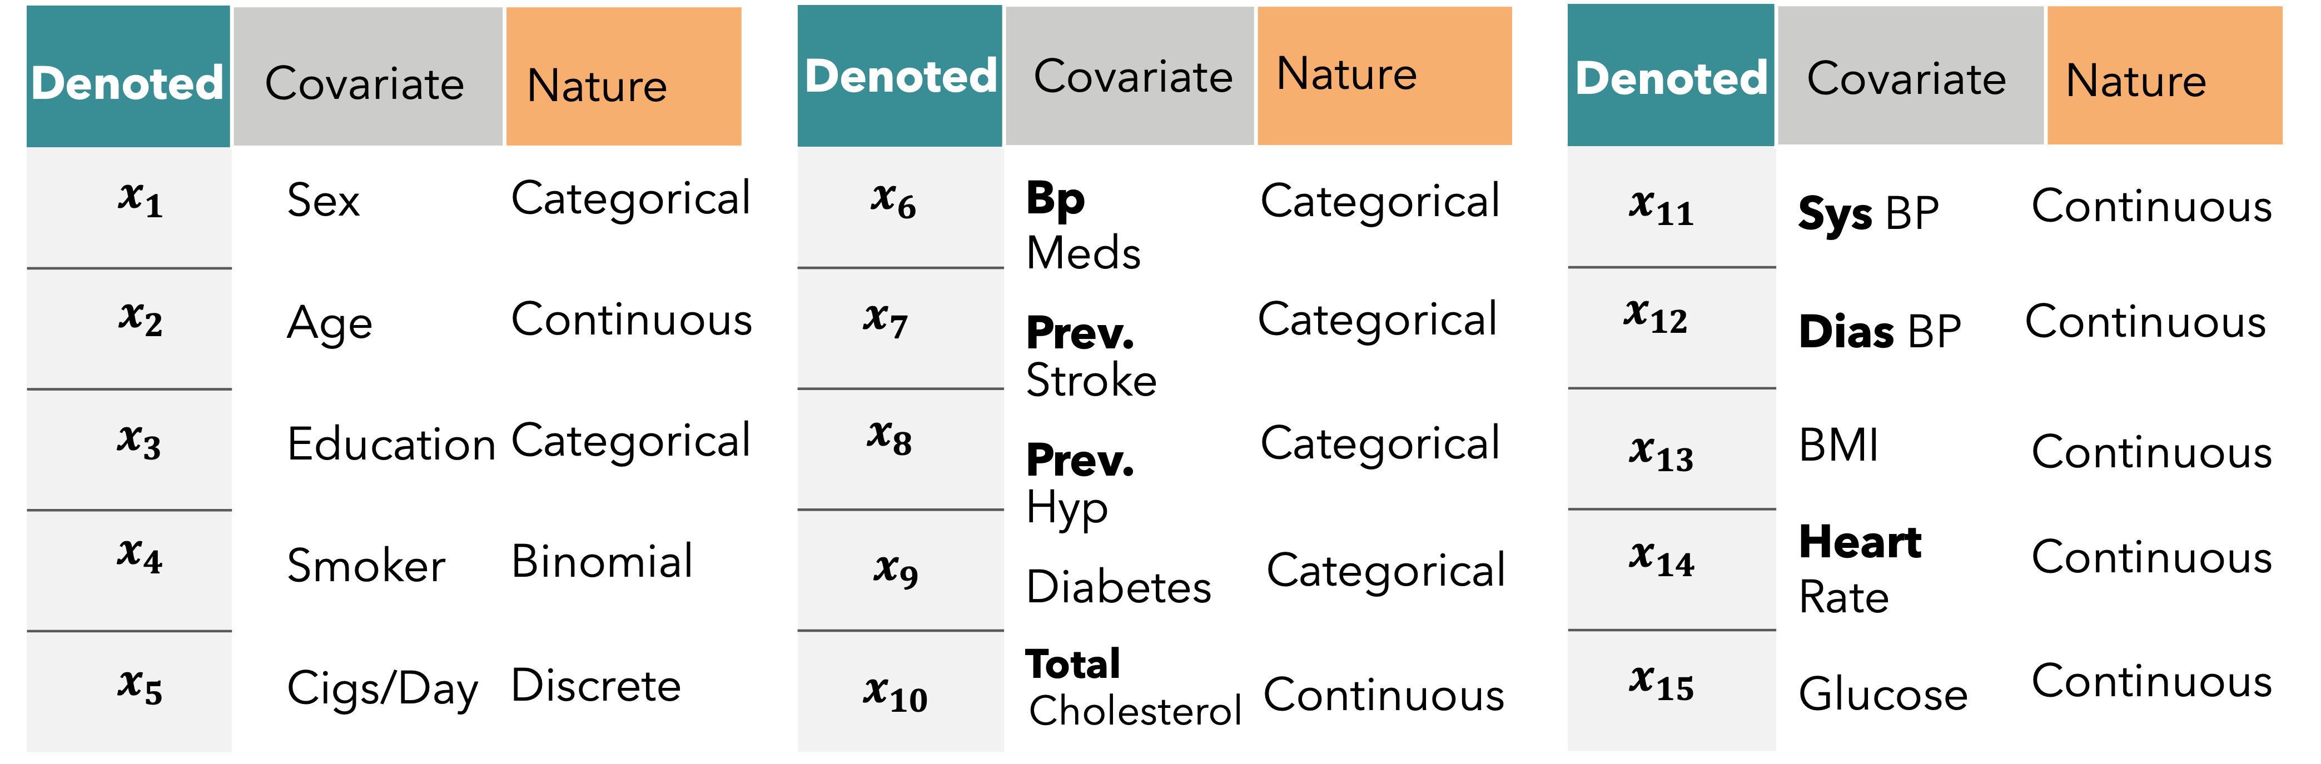
Briefly the Complete
DATASET

Slide 33
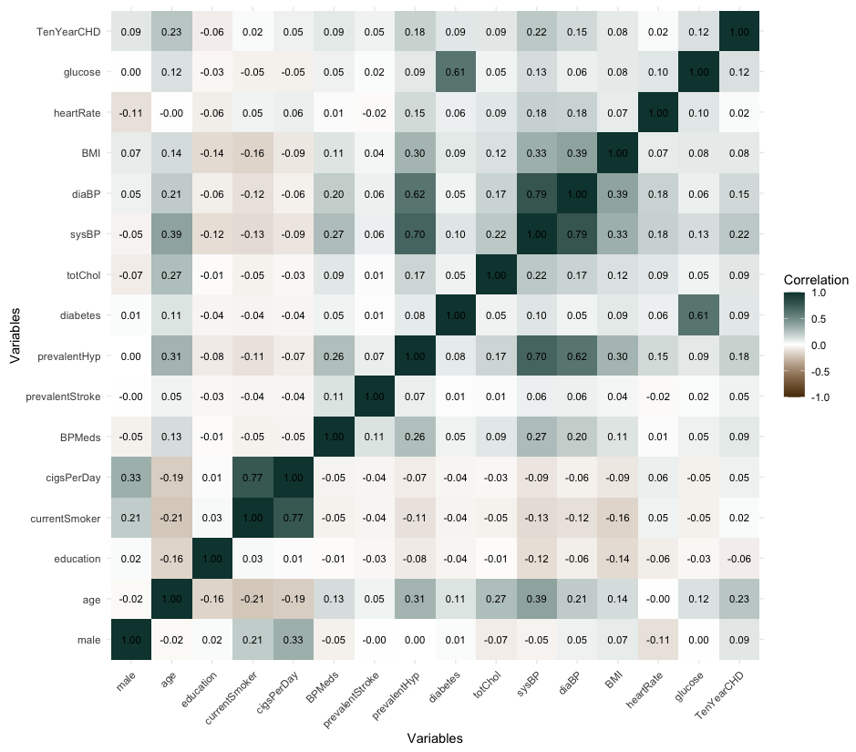
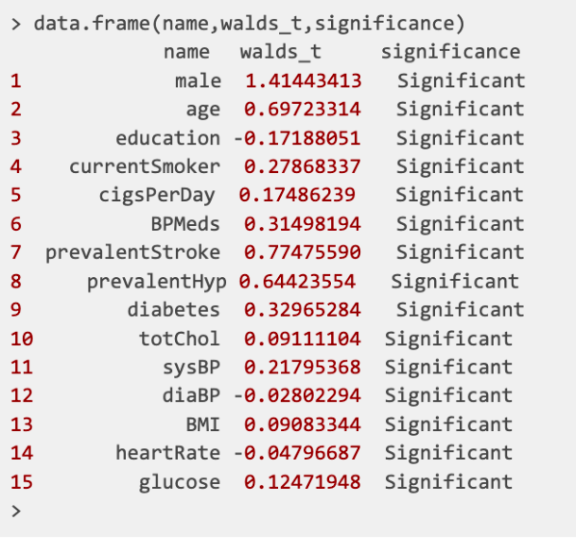
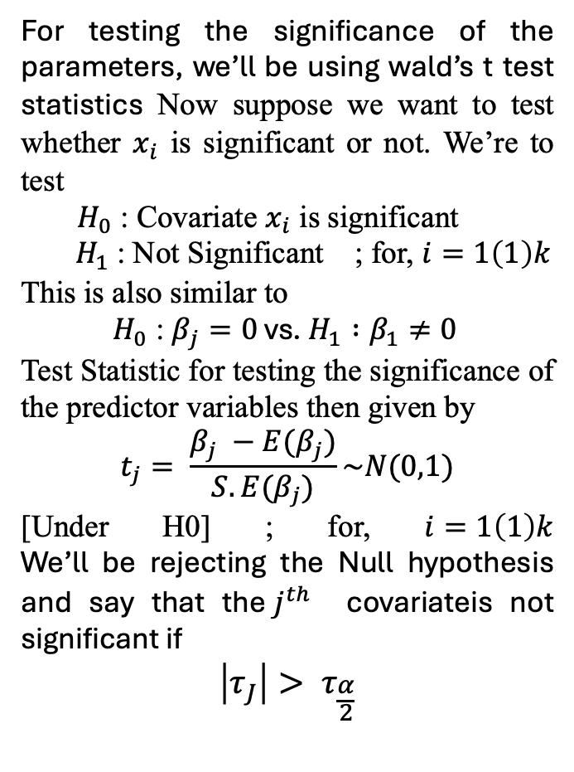
Wald’s Test for
04
02
Test Significance of
01
Checking for
Correlation
04
Significance
01
Fitting of
Parameters
Heatmap
Multicollinearity
Logistic Model
For testing the significance of the parameters, we’ll be using wald’s t test statistics Now suppose we want to test whether $x_{i}$ is significant or not. We’re to test
$H_{0}$ : Covariate $x_{i}$ is significant
$H_{1}$: Not Significant ; for, $i=1\left(1\right)k$
This is also similar to
$H_{0}$ : $β_{j}=0$ vs. $H_{1} :β_{1}≠0$
Test Statistic for testing the significance of the predictor variables then given by
$$t_{j}= \frac{β_{j} −E(β_{j})}{S.E(β_{j})}\sim N(0,1)$$
[Under H0] ; for, $i=1\left(1\right)k$ We’ll be rejecting the Null hypothesis and say that the$j^{th}$ covariateis not significant if
$$\left|τ_{J}\right|> τ_{\frac{α}{2}}$$
Multicollinearity in linear models occurs when predictors are not independent, destabilizing coefficient interpretability. It's detected when the model’s R² is high (over 0.8), but few predictors are significant, or when pairwise correlations between predictors, assessed using Karl Pearson’s coefficient, exceed 0.8. Tools like VIF and correlation heatmaps refine these assessments by visualizing interdependencies. To ensure dataset integrity for linear modelling, a detailed quantitative follow-up analysis is essential.
Considering Backward Elimination as the selected stepwise procedure, the initial model encompasses all variables. Utilizing the glm() function in R, I’ve conducted logistic regression to analyze the association between the binary response variable indicating the presence of heart disease and the fifteen distinct independent predictors [Placed in earlier Slides]. The fitting process is outlined in the code as follows:
02
Methodologies
Used for
Logistic
03
Regression
03 .1
fullmodel = glm(TenYearCHD ~ ., data = training_data, family = binomial(link = "logit"))
04

Slide 34
Wald’s Test for
04
02
Test Significance of
01
Checking for
Correlation
04
Significance
01
Fitting of
Parameters
Heatmap
Multicollinearity
Logistic Model
For testing the significance of the parameters, we’ll be using wald’s t test statistics Now suppose we want to test whether $x_{i}$ is significant or not. We’re to test
$H_{0}$ : Covariate $x_{i}$ is significant
$H_{1}$: Not Significant ; for, $i=1\left(1\right)k$
This is also similar to
$H_{0}$ : $β_{j}=0$ vs. $H_{1} :β_{1}≠0$
Test Statistic for testing the significance of the predictor variables then given by
$$t_{j}= \frac{β_{j} −E(β_{j})}{S.E(β_{j})}\sim N(0,1)$$
[Under H0] ; for, $i=1\left(1\right)k$ We’ll be rejecting the Null hypothesis and say that the$j^{th}$ covariateis not significant if
$$\left|τ_{J}\right|> τ_{\frac{α}{2}}$$
Multicollinearity in linear models occurs when predictors are not independent, destabilizing coefficient interpretability. It's detected when the model’s R² is high (over 0.8), but few predictors are significant, or when pairwise correlations between predictors, assessed using Karl Pearson’s coefficient, exceed 0.8. Tools like VIF and correlation heatmaps refine these assessments by visualizing interdependencies. To ensure dataset integrity for linear modelling, a detailed quantitative follow-up analysis is essential.
Methodologies
Considering Backward Elimination as the selected stepwise procedure, the initial model encompasses all variables. Utilizing the glm() function in R, I’ve conducted logistic regression to analyze the association between the binary response variable indicating the presence of heart disease and the fifteen distinct independent predictors [Placed in earlier Slides]. The fitting process is outlined in the code as follows:
02
03
Logistic
03 .1
Regression
fullmodel = glm(TenYearCHD ~ ., data = training_data, family = binomial(link = "logit"))
04

Slide 35
Wald’s Test for
02
04
Test Significance of
Checking for
Correlation
04
Significance
01
Fitting of
Parameters
Heatmap
Multicollinearity
Logistic Model
For testing the significance of the parameters, we’ll be using wald’s t test statistics Now suppose we want to test whether $x_{i}$ is significant or not. We’re to test
$H_{0}$ : Covariate $x_{i}$ is significant
$H_{1}$: Not Significant ; for, $i=1\left(1\right)k$
This is also similar to
$H_{0}$ : $β_{j}=0$ vs. $H_{1} :β_{1}≠0$
Test Statistic for testing the significance of the predictor variables then given by
$$t_{j}= \frac{β_{j} −E(β_{j})}{S.E(β_{j})}\sim N(0,1)$$
[Under H0] ; for, $i=1\left(1\right)k$ We’ll be rejecting the Null hypothesis and say that the$j^{th}$ covariateis not significant if
$$\left|τ_{J}\right|> τ_{\frac{α}{2}}$$
Multicollinearity in linear models occurs when predictors are not independent, destabilizing coefficient interpretability. It's detected when the model’s R² is high (over 0.8), but few predictors are significant, or when pairwise correlations between predictors, assessed using Karl Pearson’s coefficient, exceed 0.8. Tools like VIF and correlation heatmaps refine these assessments by visualizing interdependencies. To ensure dataset integrity for linear modelling, a detailed quantitative follow-up analysis is essential.
Methodologies
Considering Backward Elimination as the selected stepwise procedure, the initial model encompasses all variables. Utilizing the glm() function in R, I’ve conducted logistic regression to analyze the association between the binary response variable indicating the presence of heart disease and the fifteen distinct independent predictors [Placed in earlier Slides]. The fitting process is outlined in the code as follows:
02
03
Logistic
03 .1
Regression
fullmodel = glm(TenYearCHD ~ ., data = training_data, family = binomial(link = "logit"))
04

Slide 36
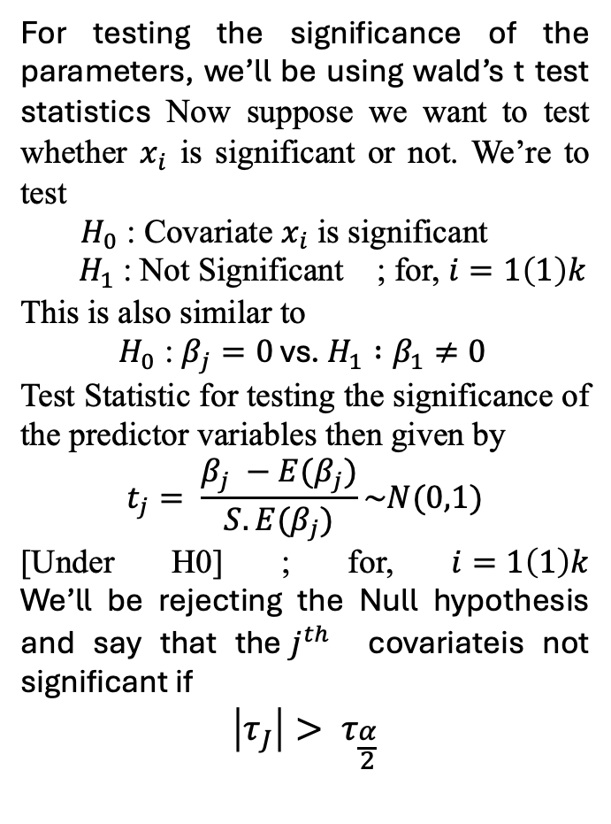
Wald’s Test for
04
Test Significance of
Checking for
Correlation
04
Significance
01
Fitting of
Parameters
Heatmap
Multicollinearity
Logistic Model
For testing the significance of the parameters, we’ll be using wald’s t test statistics Now suppose we want to test whether $x_{i}$ is significant or not. We’re to test
$H_{0}$ : Covariate $x_{i}$ is significant
$H_{1}$: Not Significant ; for, $i=1\left(1\right)k$
This is also similar to
$H_{0}$ : $β_{j}=0$ vs. $H_{1} :β_{1}≠0$
Test Statistic for testing the significance of the predictor variables then given by
$$t_{j}= \frac{β_{j} −E(β_{j})}{S.E(β_{j})}\sim N(0,1)$$
[Under H0] ; for, $i=1\left(1\right)k$ We’ll be rejecting the Null hypothesis and say that the$j^{th}$ covariateis not significant if
$$\left|τ_{J}\right|> τ_{\frac{α}{2}}$$
Methodologies
Multicollinearity in linear models occurs when predictors are not independent, destabilizing coefficient interpretability. It's detected when the model’s R² is high (over 0.8), but few predictors are significant, or when pairwise correlations between predictors, assessed using Karl Pearson’s coefficient, exceed 0.8. Tools like VIF and correlation heatmaps refine these assessments by visualizing interdependencies. To ensure dataset integrity for linear modelling, a detailed quantitative follow-up analysis is essential.
Considering Backward Elimination as the selected stepwise procedure, the initial model encompasses all variables. Utilizing the glm() function in R, I’ve conducted logistic regression to analyze the association between the binary response variable indicating the presence of heart disease and the fifteen distinct independent predictors [Placed in earlier Slides]. The fitting process is outlined in the code as follows:
02
03
Logistic
03 .1
Regression
fullmodel = glm(TenYearCHD ~ ., data = training_data, family = binomial(link = "logit"))
04

Slide 37
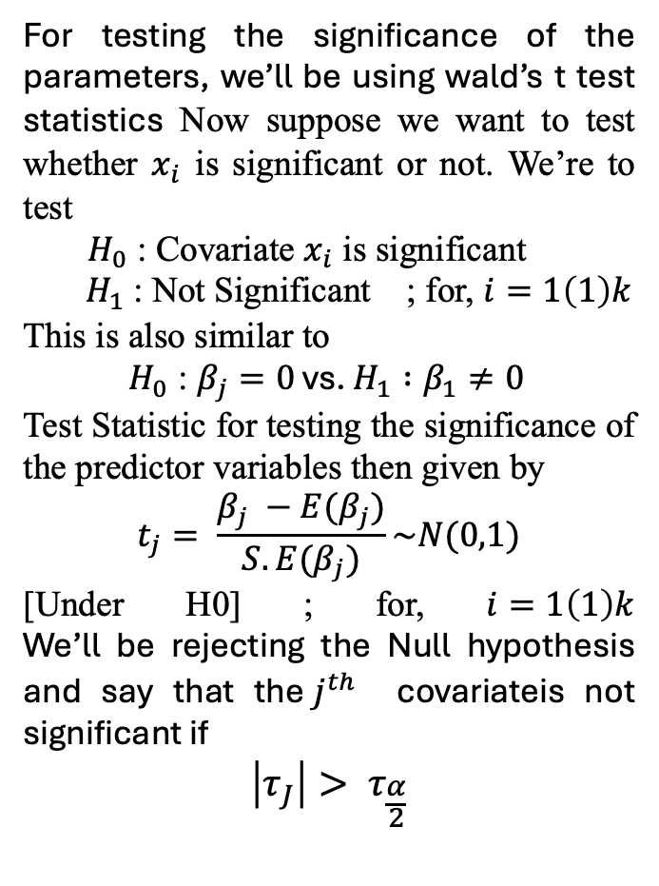
Wald’s Test for
Test Significance of
Checking for
Correlation
04
Fitting of
Significance
01
Parameters
Heatmap
Multicollinearity
Logistic Model
For testing the significance of the parameters, we’ll be using wald’s t test statistics Now suppose we want to test whether $x_{i}$ is significant or not. We’re to test
$H_{0}$ : Covariate $x_{i}$ is significant
$H_{1}$: Not Significant ; for, $i=1\left(1\right)k$
This is also similar to
$H_{0}$ : $β_{j}=0$ vs. $H_{1} :β_{1}≠0$
Test Statistic for testing the significance of the predictor variables then given by
$$t_{j}= \frac{β_{j} −E(β_{j})}{S.E(β_{j})}\sim N(0,1)$$
[Under H0] ; for, $i=1\left(1\right)k$ We’ll be rejecting the Null hypothesis and say that the$j^{th}$ covariateis not significant if
$$\left|τ_{J}\right|> τ_{\frac{α}{2}}$$
Methodologies
Multicollinearity in linear models occurs when predictors are not independent, destabilizing coefficient interpretability. It's detected when the model’s R² is high (over 0.8), but few predictors are significant, or when pairwise correlations between predictors, assessed using Karl Pearson’s coefficient, exceed 0.8. Tools like VIF and correlation heatmaps refine these assessments by visualizing interdependencies. To ensure dataset integrity for linear modelling, a detailed quantitative follow-up analysis is essential.
Considering Backward Elimination as the selected stepwise procedure, the initial model encompasses all variables. Utilizing the glm() function in R, I’ve conducted logistic regression to analyze the association between the binary response variable indicating the presence of heart disease and the fifteen distinct independent predictors [Placed in earlier Slides]. The fitting process is outlined in the code as follows:
02
03
Logistic
03 .1
Regression
fullmodel = glm(TenYearCHD ~ ., data = training_data, family = binomial(link = "logit"))
04

Slide 38
Wald’s Test for
Test Significance of
Checking for
Correlation
04
Significance
01
Fitting of
Parameters
Heatmap
Multicollinearity
Logistic Model
For testing the significance of the parameters, we’ll be using wald’s t test statistics Now suppose we want to test whether $x_{i}$ is significant or not. We’re to test
$H_{0}$ : Covariate $x_{i}$ is significant
$H_{1}$: Not Significant ; for, $i=1\left(1\right)k$
This is also similar to
$H_{0}$ : $β_{j}=0$ vs. $H_{1} :β_{1}≠0$
Test Statistic for testing the significance of the predictor variables then given by
$$t_{j}= \frac{β_{j} −E(β_{j})}{S.E(β_{j})}\sim N(0,1)$$
[Under H0] ; for, $i=1\left(1\right)k$ We’ll be rejecting the Null hypothesis and say that the$j^{th}$ covariateis not significant if
$$\left|τ_{J}\right|> τ_{\frac{α}{2}}$$
Methodologies
Multicollinearity in linear models occurs when predictors are not independent, destabilizing coefficient interpretability. It's detected when the model’s R² is high (over 0.8), but few predictors are significant, or when pairwise correlations between predictors, assessed using Karl Pearson’s coefficient, exceed 0.8. Tools like VIF and correlation heatmaps refine these assessments by visualizing interdependencies. To ensure dataset integrity for linear modelling, a detailed quantitative follow-up analysis is essential.
Considering Backward Elimination as the selected stepwise procedure, the initial model encompasses all variables. Utilizing the glm() function in R, I’ve conducted logistic regression to analyze the association between the binary response variable indicating the presence of heart disease and the fifteen distinct independent predictors [Placed in earlier Slides]. The fitting process is outlined in the code as follows:
02
03
Logistic
03 .1
Regression
fullmodel = glm(TenYearCHD ~ ., data = training_data, family = binomial(link = "logit"))
04

Slide 39
Backup Slides

Slide 40
Scope and Objective
A
B
C
D
Investigate how lifestyle choices impact heart health and explore ways to reduce the risk of cardiovascular disease (CVD).
Evaluate the imp. of
early detection in preventing severe outcomes related to CVD.
Develop and test statistical models to identify individuals at high risk of developing CVD, aiding in timely intervention and prevention.
Provide actionable insights for healthcare prof. and policymakers to make strategies for reducing the global burden of CVD.
Main Slide

Slide 41
GETTING TO KNOW THE
DATASET
Glucose
Heart
Rate
BMI
DIAS BP
SYS BP
Chol.
Diabetes
HYP
STROKE
BP
No. of
No
Origin
Glucose
Heart
Rate
BMI
DIAS BP
Cigs
No of Datapoints
Origin Of the Dataset
No of Datapoints
CHD - 10 Year Risk
Sex
Age
Education
Current Smoker
Cigs. Per Day
BP Meds
Prevalent Stroke
Prevalent Hypersensitivity
Diabetes
Total Cholesterol
Sys BP
Dia BP
BMI
Heart Rate
Glucose
In the Dataset, there are in total 3,657 data points available encompassing various demographic, behavioural, and medical risk factors.
This Cardiovascular Disease Dataset Dataset Was collected from the UCI Machine Learning Library
In the Dataset, there are in total 3,657 data points available encompassing various demographic, behavioural, and medical risk factors.
Binary Variables
Binary Variable indicating the presence (1) or absence(0) of CHD risk.
Categorical ( Nominal )
0 = Female , 1 = male
Continuous
Age in years
Categorical ( Nominal )
Denotes the Education Level of the individual.
1 : Pre-College Level
2 : Undergrad Level
3 : Postgrad Level
Categorical ( Nominal )
0 = Don’t Smoke , 1 = Smoke
Categorical ( Nominal )
0 = Don’t Smoke , 1 = Smoke
Categorical ( Nominal )
Specifies if the individual was using medication for blood pressure management..[ 0 = Not Diabetic , 1 = Diabetic ]
Categorical ( Nominal )
Identifies whether the patient has previously experienced a stroke. [ 0 = Haven’t , 1 = Have experienced ]
Categorical ( Nominal )
Indicates whether the patient is hypertensive [ 0 =Patient isn’t Hypersensitive,1=Patient is Hypersensitive ]
Categorical ( Nominal )
Identifies whether the patient has diabetes. [0 = Patient isn’t Diabetes , 1 = Patient is Diabetic ]
Continuous
Represents the total blood cholesterol level.
Continuous
Represents the systolic blood pressure level.
Continuous
Represents the Diastolic blood pressure level
Continuous
Represents the individual’s Body Mass Index
Continuous
Represents the heart rate treated as continuous due to the large number of possible values.
Continuous
Represents the heart rate treated as continuous due to the large number of possible values.

Slide 42
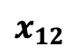
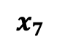
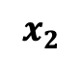
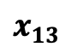
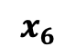
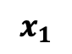
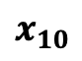
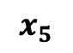
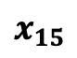
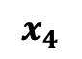
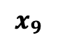
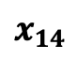
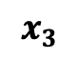
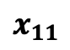
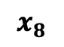
Briefly the Complete
DATASET
Denoted
Covariate
Nature
Denoted
Covariate
Nature
Denoted
Covariate
Nature
$$x_{1}$$
Sex
Categorical
$$x_{6}$$
Bp Meds
Categorical
$$x_{11}$$
Sys BP
Continuous
$$x_{2}$$
Age
Continuous
$$x_{7}$$
Prev.
Categorical
$$x_{12}$$
Dias BP
Continuous
Stroke
$$x_{3}$$
Education
Categorical
$$x_{8}$$
Categorical
$$x_{13}$$
BMI
Continuous
Prev.
Hyp
$$x_{4}$$
Smoker
Binomial
$$x_{9}$$
$$x_{14}$$
Heart Rate
Continuous
Diabetes
Categorical
$$x_{5}$$
Cigs/Day
Discrete
$$x_{10}$$
Total
$$x_{15}$$
Glucose
Continuous
Cholesterol
Continuous

Slide 43
3
Introduction
Indian Statistics
Global Statistics
In 2016, INDIA reported 63% of total deaths due to NCD. Of which 27% were attributed to CVD.
Total 17 millions premature Deaths Worldwide in 2019. 38% were caused by the CVD. This cause for 45% of deaths in 40-69 years age group.
Medical professionals have dedicated enormous effort to the treatment and diagnosis of heart disease. Recognizing the potential impact on humanity.
Backup Snippet

Slide 45
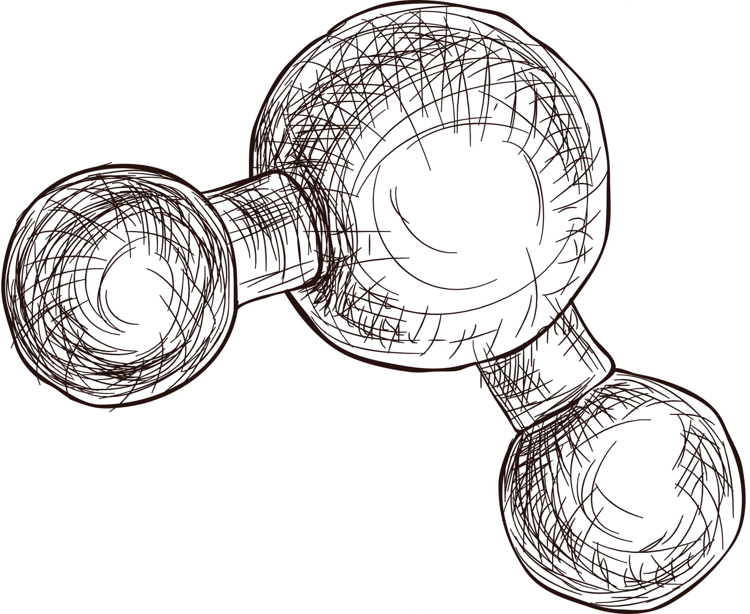

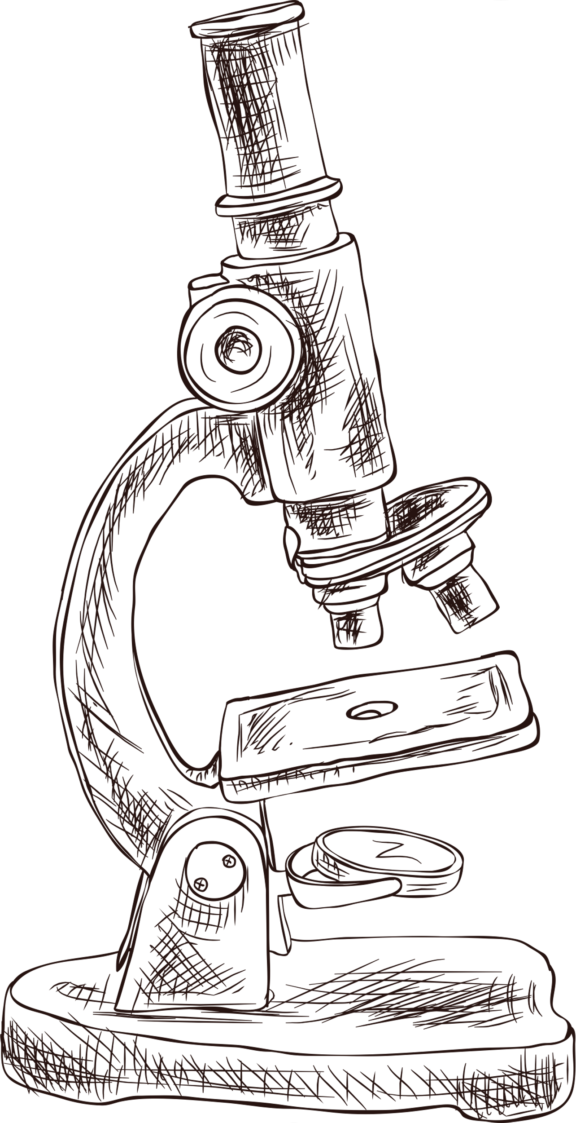


Thank
you!
Do you have any questions?
www.reallygreatsite.com

